Slide 1
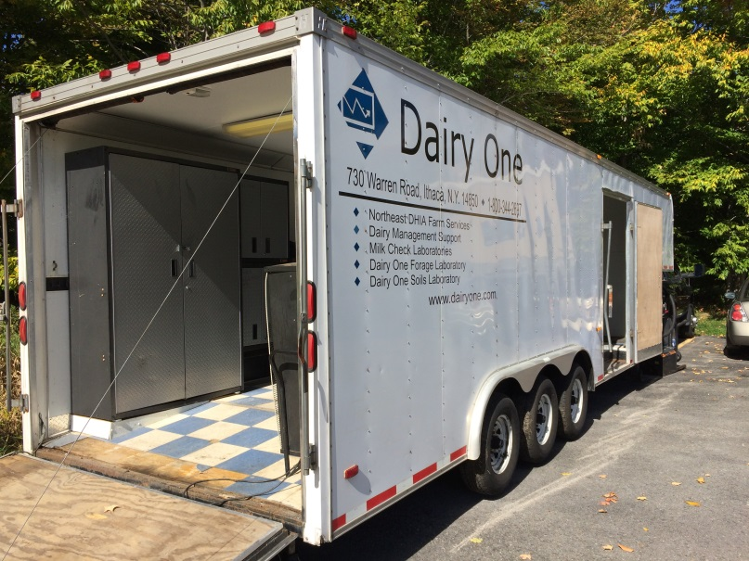
Auditing Procedures for Meter Centers and Technicians
2017 Meter Technician Training School
Steven Sievert
Manager, Quality Certification Services Inc.
Technical Director, National DHIA
Chair, ICAR Subcommittee for Recording and Sampling Devices

Slide 2
Topics to cover today
Certification and Audit Definitions
Changes in the Auditing Guidelines
Meter Center and Meter Technician Auditing Procedures
Observations from Meter Center Audits

Slide 3
  Quality Certification Services is a
  wholly-owned subsidiary of National DHIA

Slide 4
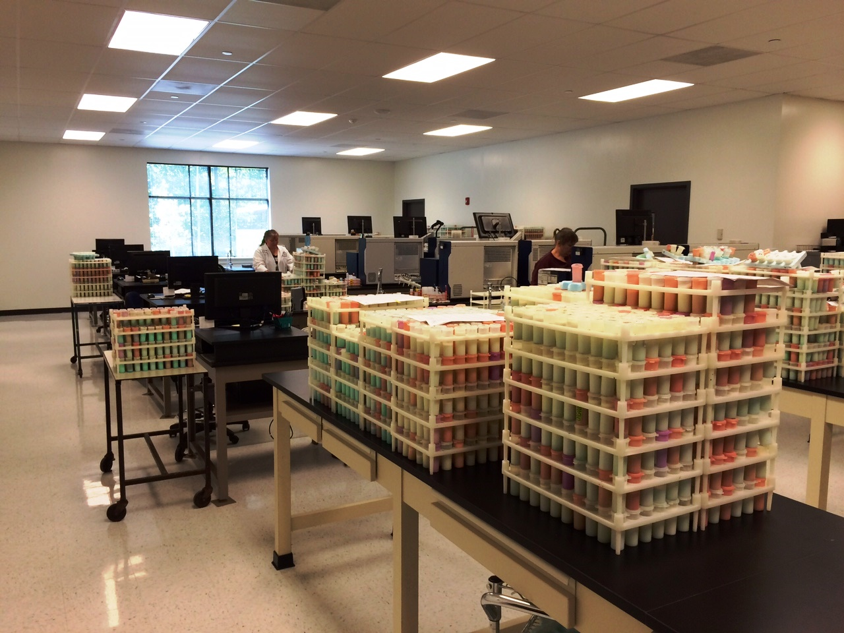
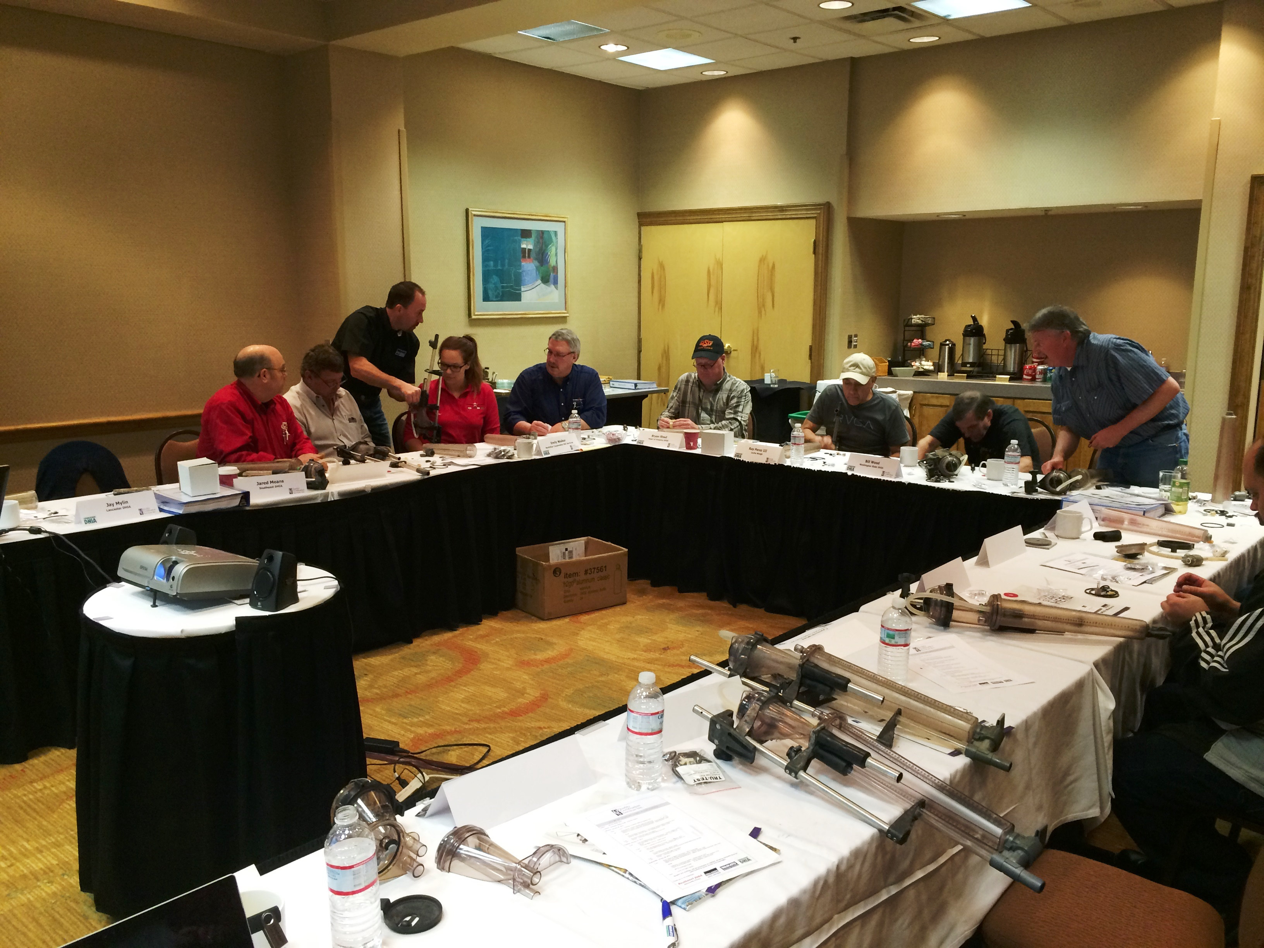

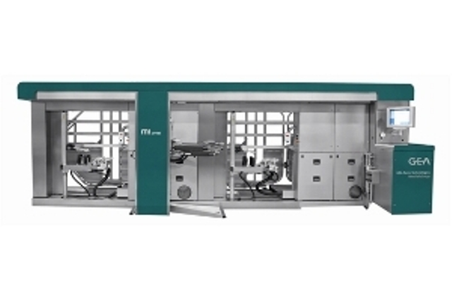
Areas of
Work
Auditing of Providers
Internal Support for Program Participants
External Industry Liaisons

Slide 5
Role of quality certification in the dhi industry

Slide 6
Overview of Herd Testing
in the U.S.
Consultants, Vets & Nutritionists
Laboratory
Dairy Farm
CDCB-AIPL
DRPC
Field
Service
Provider
Breed
Associations
Meter
Center
AI Organizations
Interbull

Slide 7
Common Complaints from Dairymen
Field Technician does not show up on time
Field Technician does not test regularly (desire monthly testing)
Field Technician appearance/behavior is not professional
Field Technician is not mixing samples properly
Sample ID accuracy
Meters do not operate properly
Meters are dirty
Meters are old (or appear to be old)
Lab accuracy and turn-around time
Data entry errors/handling
Data turn-around time

Slide 8
Quality Certification in the United States
  Program is user-driven
    Guidelines developed by service providers for each area
    Review and recommendation by Audit Review Committee (ARC)
    Approval by Council on Dairy Cattle Breeding (CDCB)
      Records Providers (DRP-DHI)
      Dairy Records Processing Centers (DRPC)
      Breed Associations (PDCA)
      A.I. Organizations (NAAB)
  Our Mission
  Provide a reliable source of information
  to people interested in the
  U.S. dairy records industry

Slide 9
QCS Auditing Program in 2016
24 Field Service affiliates working with 1,967 Field Technicians and Technician Assistants (includes full time, part time, and ISPs and their staff)
38 Meter Centers and 76 Meter Technicians that calibrated 78,147 certified portable meters in 2016
Dairy operations using 141,209 certified electronic on-farm meters
44 Laboratories analyzing an average of 5.02 million milk samples monthly
4 Dairy Records Processing Centers (DRPC) processing cow data
18 ELISA Laboratories screening milk samples for Johne’s

Slide 10
Working with Advisory Committees
Advisory Committees to review guidelines for each sector, to assure program relevance, and incorporate new technology where appropriate
QCS Advisory Committee George Cudoc, Dairy One Cooperative, Chair
Field Service Advisory Committee Anita Quesenberry, United DHIA, Chair
Laboratory Advisory Committee John Rhoads, Eastern Laboratory Services, Chair
DRPC Advisory Committee Bill verBoort, Agritech Analytics, Chair
Audit Review Committee Bruce Dokkebakken, Minnesota DHIA, Chair
CDCB Committees and Teams
Pursuing Data Quality (PDQ) Team Steven Sievert represents National DHIA
Angie Coburn represents AgSource Coop DRPC
Data Access Technical Group Steven Sievert represents National DHIA

Slide 11

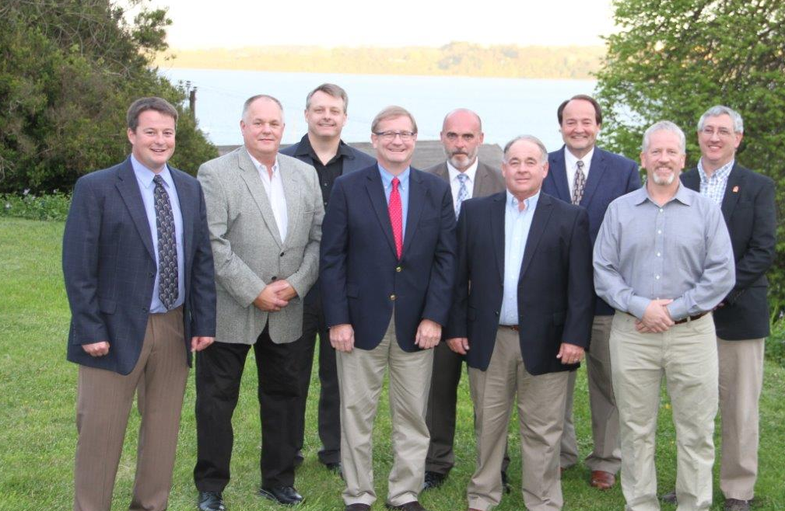
Jay Mattison, National DHIA
Vice President, ICAR Board of Directors
Animal Identification Subcommittee
Steven Sievert, National DHIA
Chair, Recording & Sampling Devices Subcommittee
Chair, Sensor Devices Task Force
John Rhoads, Eastern Lab Services
Milk Analysis Subcommittee
Kevin Haase, NorthStar Cooperative
Dairy Cattle Milk Recording Working Group
Providing Leadership to ICAR

Slide 12


















Working with Milking Equipment Manufacturers
Multifaceted approach working directly with manufacturers and with local dealers to support needs of our field service affiliates

Slide 13
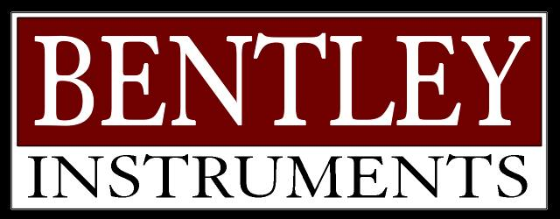








Working with Laboratory Vendors & Suppliers

Slide 14

Assuring Data Accuracy is the Role of QCS
Consultants, Vets & Nutritionists
Laboratory
Dairy Farm
CDCB-AIPL
DRPC
Field
Service
Provider
Breed
Associations
Meter
Center
AI Organizations
Interbull

Slide 15
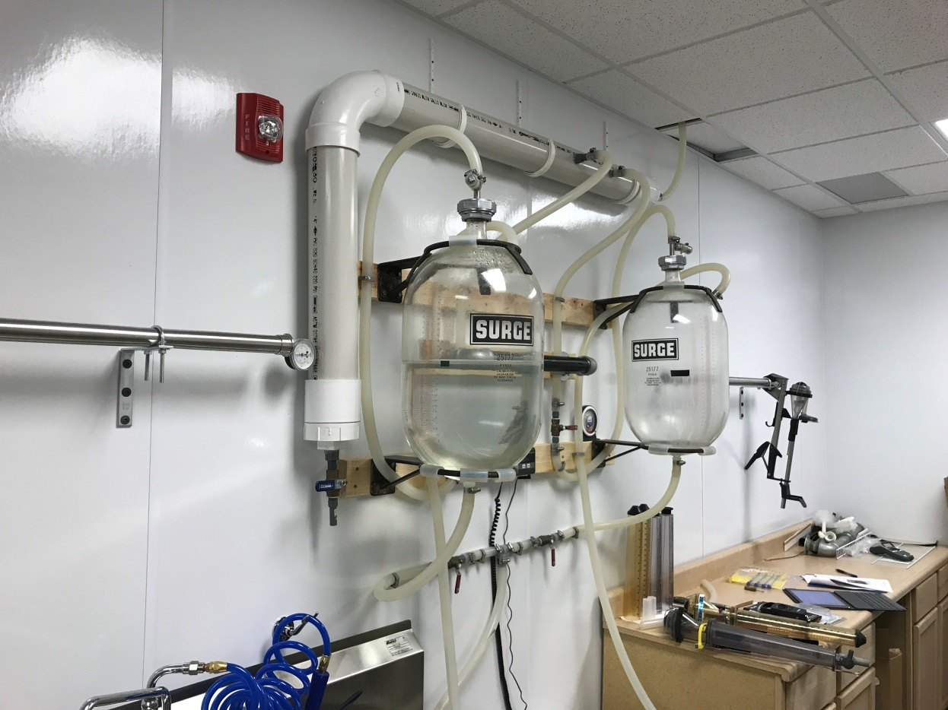

What are the Meter Centers?

Slide 16
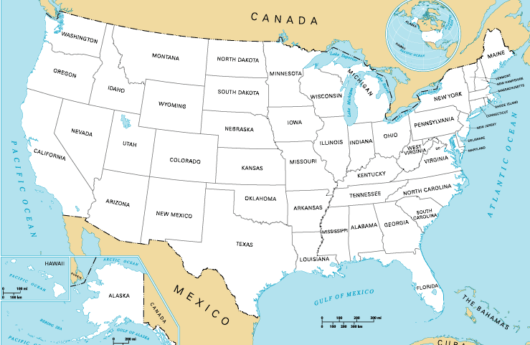
Certified Meter Centers

Slide 17
Calibration of Meters a Priority
  40 certified meter centers in the U.S.A and Mexico
  80 certified meter technicians
  Meters must be calibrated every 12 months (not 14)
  Uniform calibration and performance guidelines
Meter Center Audits
Every 2 Years
Meter Technician Audits
Every 2 Years
Meter Technician Training
Required Every 5 Years
Manufacturer Supported
Portable & Stationary Calibration Centers
Maintenance/Calibration

Slide 18
QC – Everyone’s Responsibility
Accuracy and reliability of data
Levels the playing field for all providers
Independent of size, structure or geographic location
Dairies, Studs, Breed Associations, etc. all trust us to do the job right
Quality data at the dairy level to make educated decisions

Slide 19
The Challenge is…
You control your image…
  Professional appearance
  Properly operating equipment
  Proper technique
  Exceed the minimum QC requirements
  Communicate your needs with management
Resulting in…
  Accurate and consistent results
  Fewer concerns and/or complaints from dairymen
  Customer retention and satisfaction

Slide 20
Certification status definitions

Slide 21
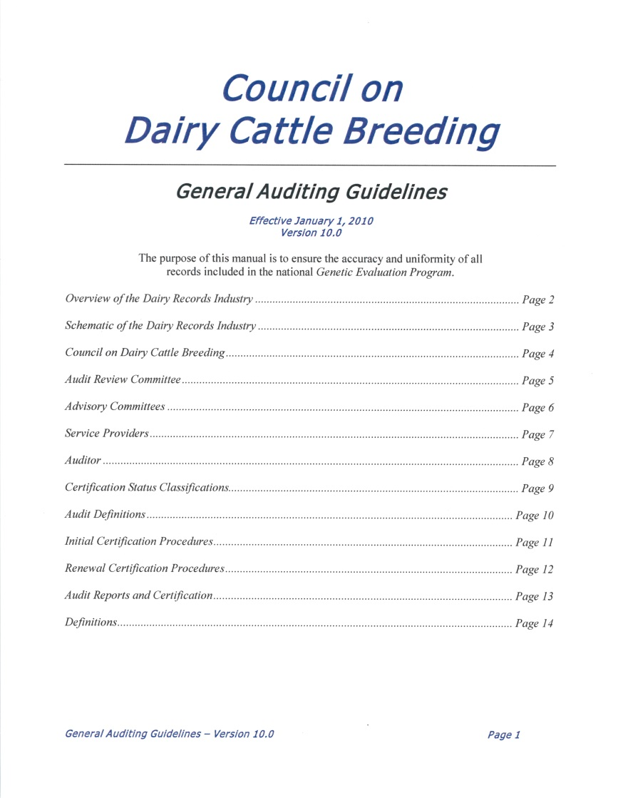
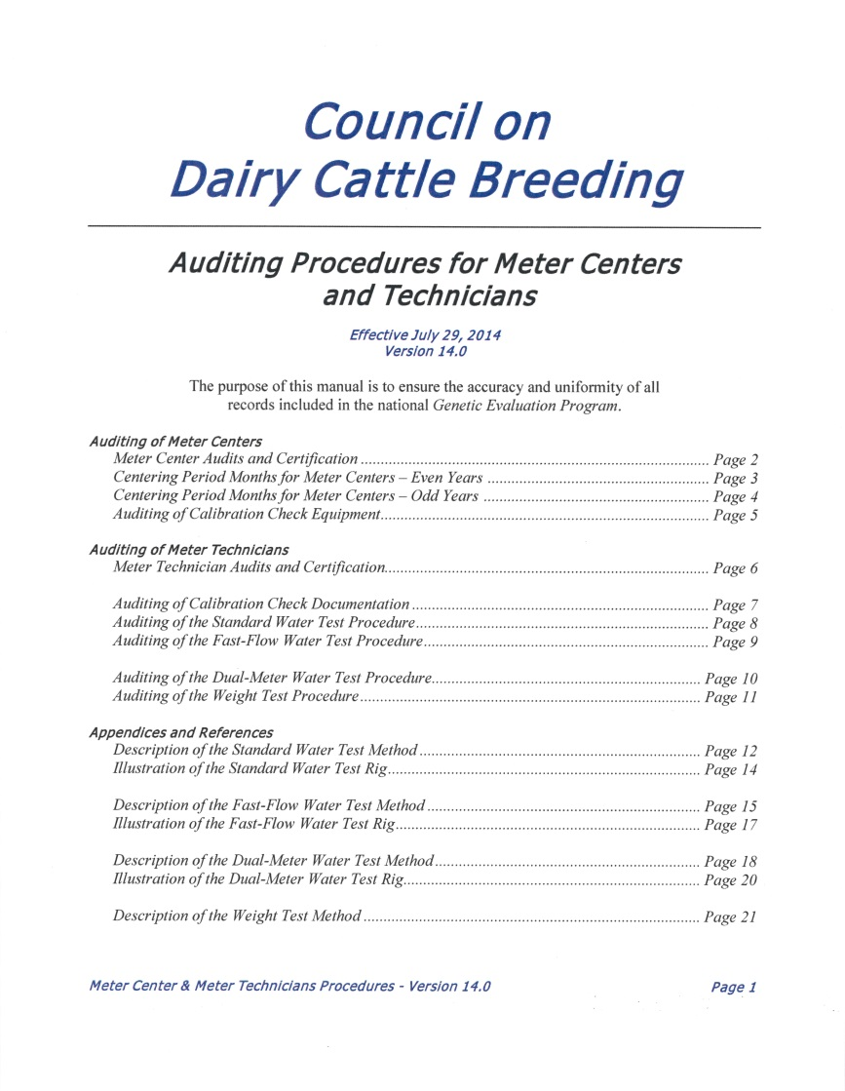
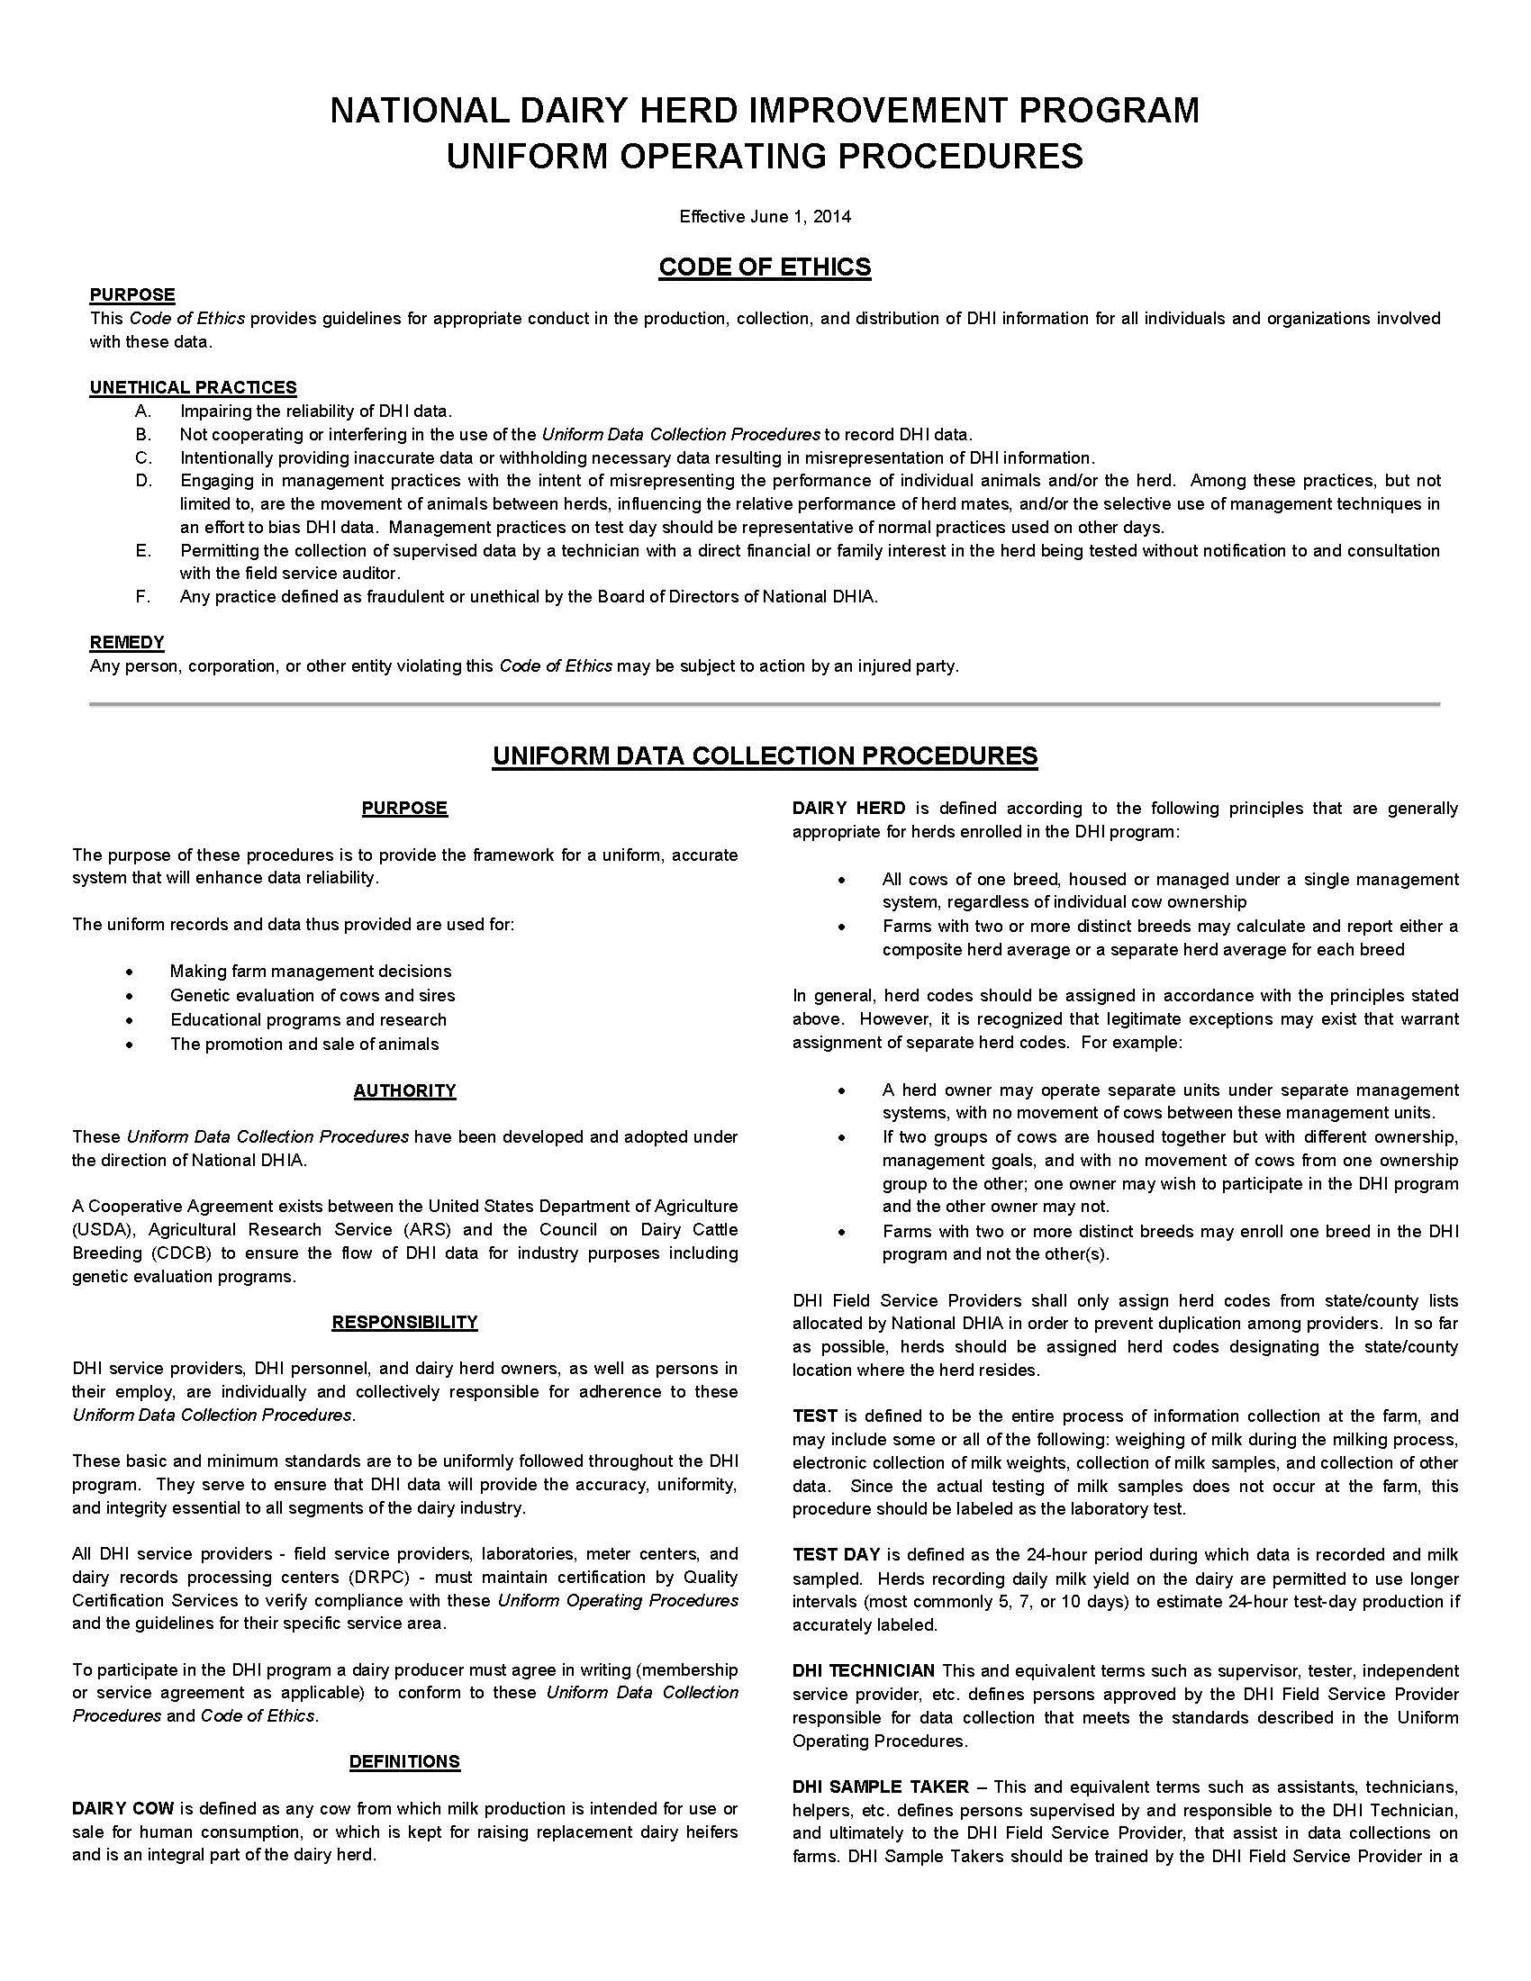
Reference Documents

Slide 22
Certification Status Definitions
Certified
A “certified” provider is one that in compliance with the Council on Dairy Cattle Breeding (CDCB) guidelines and the Uniform Operating Procedures (UOP) for its service area.
Provisional
Conditional
Decertified
In Review

Slide 23
Certification Status Definitions
Certified
Provisional
A provider is not in compliance with one or more aspects of the CDCB guidelines and/or the UOP will be deemed as “provisional.” Upon coming into compliance and review by the auditor, the provider may be:
  restored to full certification,
  designated conditional until an audit is conducted,
  designated provisional for an additional period of review, or
  decertified.
Conditional
Decertified
In Review

Slide 24
Certification Status Definitions
Certified
Provisional
Conditional
A “conditional” certification status may be assigned to both new and existing service providers. A new service provider may be assigned conditional status if the auditor believes that the provider has demonstrated competency to perform necessary procedures meeting CDCB guidelines and/or the UOP, but has not undergone a full on-site audit. An existing provisional provider may be assigned conditional status if the auditor believes that the provider has met all conditions or deficiencies outlined as part of a previous audit.
Decertified
In Review

Slide 25
Certification Status Definitions
Certified
Provisional
Conditional
Decertified
A provider that is out of compliance with the CDCB guidelines and/or the UOP, even after a period of provisional certification and review, will be “decertified” by the auditor. A decertified provider will not be allowed to submit data to the Genetic Evaluation Program. Further, data for management purposes will be designated as ‘non-certified.’
In Review

Slide 26
Certification Status Definitions
Certified
Provisional
Conditional
Decertified
In Review
A provider may be listed as 'in review' on the website. This is not an official certification status, but simply a temporary designation used while the audit is being conducted and data evaluated. During this review period, the auditor may request additional documentation from the provider. The length of the review process is not an indicator of certification status and should not be construed as such.

Slide 27
Definition of audit types

Slide 28
Audit Definitions
Off-Site (applies to Field Service and DRPCs only)
On-Site
  Mandatory
    Regularly scheduled audit conducted during the centering month
  Discretionary
    Deemed necessary by either the auditor or provider when:
      Changes in facilities, equipment, or staffing have occurred,
      Certain aspects of the provider’s performance are out of compliance with CDCB guidelines and/or the UOP,
      Provider wishes to attain full certification from a conditional status,
      Provider wishes to regain full certification from a provisional status, or
      Provider wishes to regain provisional certification from a decertified status

Slide 29
Changes in the auditing guidelines

Slide 30
Changes in the Guidelines
All changes originate with Field Service Advisory Committee (FSAC)
  Anita Quesenberry (United DHIA) is chair
Sent to Audit Review Committee (ARC) for review and approval
  Bruce Dokkebakken (Minnesota DHIA) is chair
Final approval by CDCB Board of Directors

Slide 31
Calibration Wand Requirements
Required Use of Manufacturer’s Approved Wand – January 1, 2012
Standard Flow and Dual Meter Procedures - new wand available from Waikato USA
Fast Flow Procedure – wand available from Tru-Test.
No PVC wands – breakage, air leaks, etc
Closed jar-to-jar systems for are okay with auditor’s approval

Slide 32
Standard Flow Calibration Wand
  Waikato and QCS met in August 2010 on development of stainless steel ‘standard-flow’ calibration wand
  Works with Tru-Test pail and existing mounting brackets
  Includes restrictor, air admission orifice
  For all standard flow and dual-meter calibration procedures
  May be used for Tru-Test, FOSS & Waikato meters
  Required by January 1, 2012
  Available from Waikato Milking Systems USA

Slide 33
Meter Technician Training
Meter Technician Training Requirement
In order to retain certification, each meter technician is required to attend a meter technician training school approved by the auditor at least once every five years.
Ensures that all meter technicians are current with respect to meter repair and maintenance along with providing a venue for exchange of ideas/tips/experiences between meter technicians.

Slide 34
Service Provider Responsibilities
Service Provider Responsibilities
To notify the auditor of changes in ownership, location address, billing address, list of customers and/or affiliates, equipment or meter technicians within 30 days.
To pay the fees charged by the auditing organization prior to issuance of certification. For those providers certified biennially, but billed in annual installments, certification will be issued on an annual basis with a renewal on receipt of the second installment payment.

Slide 35
Auditing procedures

Slide 36
General Audit Information
Biennial, on-site mandatory audits for all meter centers
  Stationary
  Portable
Designated centering months
  26-month certification period
  Annual fees must be paid to receive certification for the 2nd year
Discretionary audits for:
  New meter centers and technicians
  New calibration equipment or new calibration procedures
  Provisional or conditional providers in order to regain certification

Slide 37
Basic Meter Center Equipment
Current meter manuals
Parts supply for meter repair/maintenance
Clean, solid, well-built and in good repair
Initial volume verification
  Volumetric flask or digital scale
Ongoing volume confirmation
  Working & accurate scale, properly working float pail
Stable vacuum source @ 15” Hg with short recovery time (<10 seconds ideal)

Slide 38
Standard Flow Water Test Equipment
Restrictor orifice at the inlet of wand
  Fixed diameter, ahead of air admission orifice
Air admission orifice in the calibration wand
  24-36” from meter inlet
  #60 drill bit size hole in wand
Level and secure hanging bracket
No set meter height (standard flow test only)
  New wand uses same height at Fast Flow Procedure
Flow rate
  8 lbs./minute or about 4:34 for 36.4 lbs

Slide 39
Dual Meter Water Test Equipment
Same equipment as Standard Flow Equipment
Requires adequate vacuum reserve capacity
Air admission orifice in the calibration wand
  24-36” from meter inlet
  #60 drill bit size hole in wand
Level and secure hanging bracket for both meters
Second hose connecting first and second meters
  24-36” from outlet of meter #1 to inlet of meter #2
  No air admission orifice in the second hose
Flow rate
  8 lbs./minute or about 4:34 for 36.4 lbs

Slide 40
Fast-Flow Water Test Equipment
Tru-Test and FOSS meters only
Approved Fast Flow rig
Pail with anti-vortex baffle
Level and secure hanging bracket
Straight inlet tube w/ castellated orifice
  63” from inlet opening to top of meter flask
Flow rate for 16.0 liters
  58-63 seconds for wide bore meters
  68 seconds for standard bore meters

Slide 41
Weight Test Method Equipment
Weights accurate to 2%
Weights capable of checking:
  10 – 20 – 30 – 40 – 50 pound checkpoints
Approved scale models only
  American Weigh-Scales, Chatillon, Detecto, Hansen, Pelouze, Salter-Brucknell, Stewart-Oster, Taylor-Wharton
If calibrating scales for goats…
  need to also have 1, 2, and 5 pound weight checkpoints

Slide 42
Meter Technician Audits
Verification of training
  Attendance at QCS Meter Technician Training School once every five years
  Attendance at local affiliate and/or manufacturer sponsored workshops
Must demonstrate all test methods used in meter center
  Standard Flow
  Dual Meter (not every meter center can run this)
  Fast Flow
  Weight Test (if hand scales are in use)

Slide 43
Meter Technician Audits
Demonstration of proper number of calibration checks
  1 time if within 2%
  2 times if within 2-3%
Demonstration of meter repair/maintenance
Demonstration of meter identification, record keeping and data recording

Slide 44
Meter Technician Certification
Certification is meter model specific
    TeSa Milk-o-Meter – expired December 31, 2010
    Foss Milk-O-Scope
    Tru-Test Auto Sampler models
    Tru-Test Economy models
    Tru-Test Electronic milk meters
    Tru-Test Ezi-Test models
    Tru-Test Farmer models
    Tru-Test Pull-Out models
    Waikato Mark 5
    Waikato SpeedSampler

Slide 45
Observations from meter center audits

Slide 46
Certified DHI Portable Meters – 2016
Model | Model | 2012 | 2013 | 2014 | 2015 | 2016
FOSS | Milko-Scope | 108 | 96 | 31 | 31 | 33
Tru-Test | Auto Sampler (SB & WB Models) | 20,141 | 18,518 | 17,558 | 16,884 | 16,903
Tru-Test | Economy (SB) | 1,947 | 1,881 | 1,742 | 1,313 | 1,097
Tru-Test | Electronic Milk Meter | 893 | 426 | 405 | 450 | 550
Tru-Test | Ezi-Test (SB & WB Models) | 8,101 | 8,418 | 8,624 | 8,917 | 8,648
Tru-Test | Farmer (SB) | 4,229 | 3,918 | 3,278 | 2,993 | 2,793
Tru-Test | Pullout (SB & WB Models) | 43,947 | 41,902 | 39,873 | 39,105 | 39,174
Waikato | MK V (includes farmer-owned) | 8,012 | 8,916 | 8,745 | 8,846 | 8,817
Waikato | SpeedSampler | 208 | 186 | 179 | 168 | 132
Total |  | 87,586 | 84,261 | 80,435 | 78,707 | 78,147

Slide 47
Portable Meter Calibration Performance in 2016
  * Meters are required to be calibrated at least once every 365 days
    * There were 2 field service providers with 100% <365d in 2016
 | Best Service Provider | Poorest Service Provider | 2015 Weighted Mean | 2016 Weighted Mean | AgSource 2016
Not Calibrated | 0% | 27.9% | 0.5% | 0.8% | 0.0%
% <365 days | 100%* | 0% | 50.2% | 52.7% | 76.3%
% between 365-425 days | 0% | 0% | 40.4% | 35.0% | 23.7%
>425 days | 0% | 100% | 9.4% | 12.3% | 0.0%

Slide 48
Portable Meters and Scales
Inventories are either excellent or poor
  Accuracy in reading serial numbers
  Recording model types
  Status – In? Out? Storage?
  QCS can handle multiple calibration dates
Record weights from all calibration runs
12 month interval is requirement!
  Audit guidelines allow 14 months ‘in certain cases’
  More prevalent problem with ISP technicians

Slide 49
Usage of Meters
Field Service Affiliate | No. Meters | Cows/Meter/Year | Times Calibrated/Year
A | 3,131 | 896 | 4x to 12x
B | 4,965 | 2,429 | 1x
C | 5,708 | 1,301 | 1x to 2x
D | 10,511 | 882 | 1x
E | 1,307 | 1,068 | 1x
F | 2,076 | 694 | 2x
G | 364 | 4,185 | 1x
H | 184 | 6,916 | 2x

Slide 50
Availability of Meters and Parts
Meter centers with different meter models need to have at least one functioning meter of each model available during the audit
Parts need to be available for both routine maintenance and repairs – especially if needed during the audit
Eight (8) meter center audits in the last three years
had to be rescheduled due to lack of parts or
failure to have meters models in use available at the audit
If we cannot calibrate it or fix it – how can we certify it?

Slide 51
Use of Float Pails
Float pails are used to verify water volume between calibration runs
Many of the floats are broken or cannot be adjusted
An affordable alternative is the use of a digital scale to verify both initial and intermediate water volume
Improves accuracy and potentially reduces repair costs

Slide 52
Condition of Equipment
Aging meter centers and equipment
Check hoses for wear, air leaks, cracks
Maintenance of vacuum pumps a concern in some meter centers
Take care of your wands
  Damaged wands
  Worn castellated orifices
  Worn shut-off valves that leak air

Slide 53
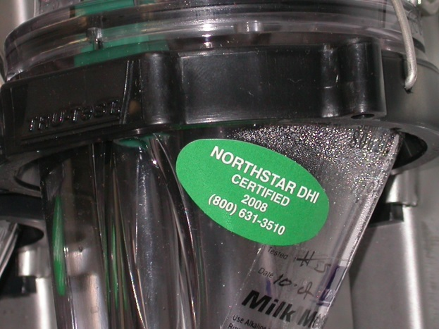
Post-Calibration Meter Procedures
An important part of meter calibration includes what happens after the run
  2nd runs if needed (<35.5 lbs. or >37.1 lbs.)
  Recording data – all calibration results
  Identifying with certification tag/sticker
Lost calibration worksheets, no backup files – this delayed/affected 4 field service audits in 2015 and 2 field service audits in 2016

Slide 54
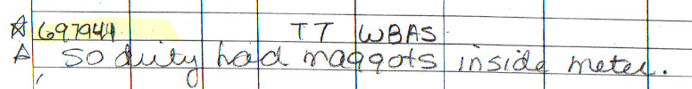
Record Your Observations
Parts replacements
  Annual Service Kits
  Other parts (caps, nozzles, T-Pieces, etc.)
Verify the model of meter and record any corrections
Meter condition and cleanliness

Slide 55
Quality Certification Services Inc.
Performance & Quality Standards
Compliance Auditing of Providers
Education, Training, & Development
A simple, yet vital mission….
Providing a reliable source of information to people interested in the U.S. dairy records industry.

