Slide 1
Calibration of Portable Scales
2017 Meter Technician Training School
Steven Sievert
Manager, Quality Certification Services Inc.
Technical Director, National DHIA
Chair, ICAR Subcommittee for Recording and Sampling Devices

Slide 2
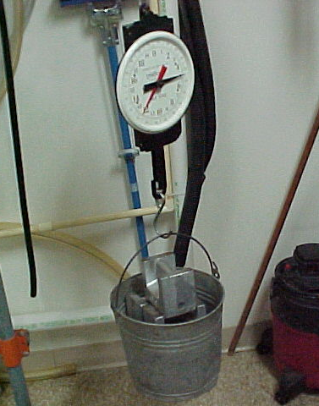
Scale Calibration Requirements
All scales must be calibrated at least once every 12 months
Calibrated to:
2% accuracy on single weight
3% accuracy on two consecutive weights
Data is reported to QCS as part of annual field service audit

Slide 3
Scale Calibration Requirements
Must calibrate at each of the following weights…
Dairy Cows
10, 20, 30, 40, 50 lbs.
Dairy Goats/Sheep
1, 2, 5, 10, 20 lbs.
Refer to chart in MTTS Manual for acceptable weight readings

Slide 4
Scale Calibration Requirements
Every scale must have unique serial number
Each scale must be marked with calibration tag/sticker
Month & Year
Meter Center Used
Meter/Scale Technician

Slide 5
Reporting Scale Calibration Results
Scale no | FT | Make | Model | 2013 Date | 2014 Date | Int | MC | MT | 1# | 2# | 5# | 10# | 20# | 30# | 40# | 50# | 2015 Status | 2016 Status
174434 | 999 | AWS | PK-110 | 7/7/2016 | 9/12/2016 | 67 | Meter Center Name | Meter Tech Name | 1 | 2 | 5 | 10.1 | 20.1 | 30.2 | 40.4 | 50.4 |  | New 2016
Proper reporting improves audit efficiency
Unique serial number – avoid alphanumeric values
Make and model of scale
Calibration date(s)
Meter center and technician name
Calibration weights at each level
Status during the audit period

Slide 6
Reporting Scale Calibration Results
Suggested Status Codes for Scale Calibration Worksheets
Active
New (+ year) – scale new from the box
Return (+ year) – repaired scale or returned to active status
Storage – calibrated scale not in active use (backup)
Out (+ year) – scale taken out of service
Perm Out or POS – broken scale that cannot be repaired
Goats – scale that has only been calibrated for goats

Slide 7
Scales Suitable for DHI Programs

Slide 8
Hanson Dairy Scale 600
The old ‘standard’ for DHI milk weighing
No longer manufactured
Can reface the scale with new label – contact auditor
Maintains calibration over the weight range

Slide 9
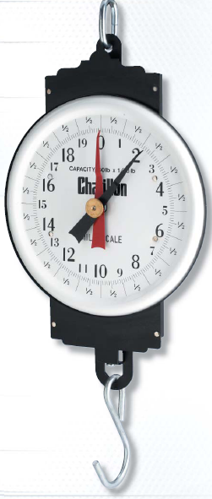
Chatillon MD-60
Designed specifically for dairy applications
Easy to read
Heavy gauge steel construction, baked enamel finish
Expensive purchase price but durable
Easy to calibrate

Slide 10
Detecto MCS-60M
Designed specifically for dairy applications
Accurate weighing at all levels
Combination plastic and steel
Expensive purchase price but durable
Easy to calibrate

Slide 11
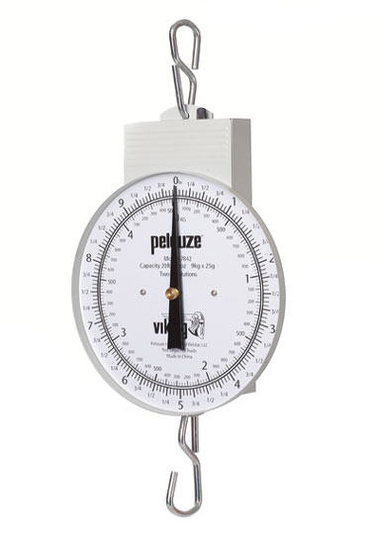
Pelouze (Viking) 7800 and 7842
Low-cost scale
Metal construction, baked enamel finish
Moderately durable, can lose calibration easy
Does not like travel
Marketed by some dairy supply places as replacement for the Hanson scale

Slide 12
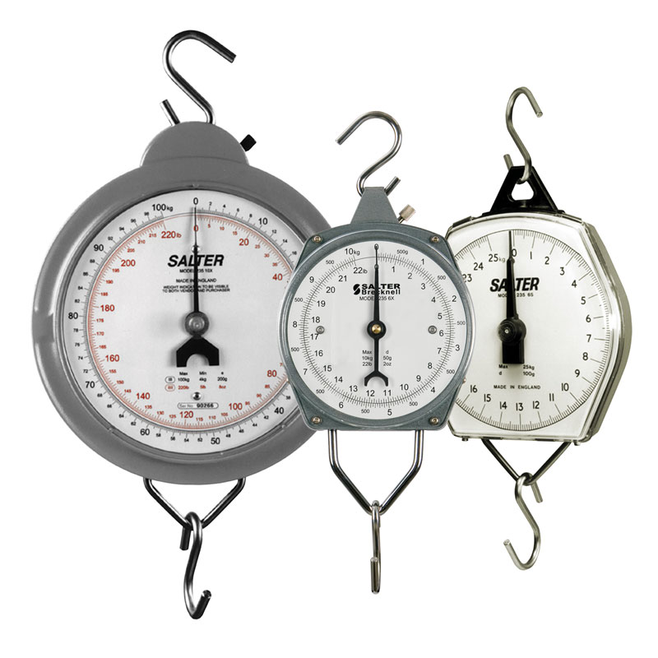
Salter Brecknell 235-Series
Medium cost point
Metal construction, baked enamel finish
Moderately durable

Slide 13
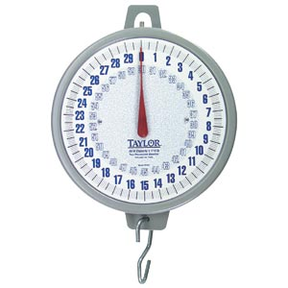
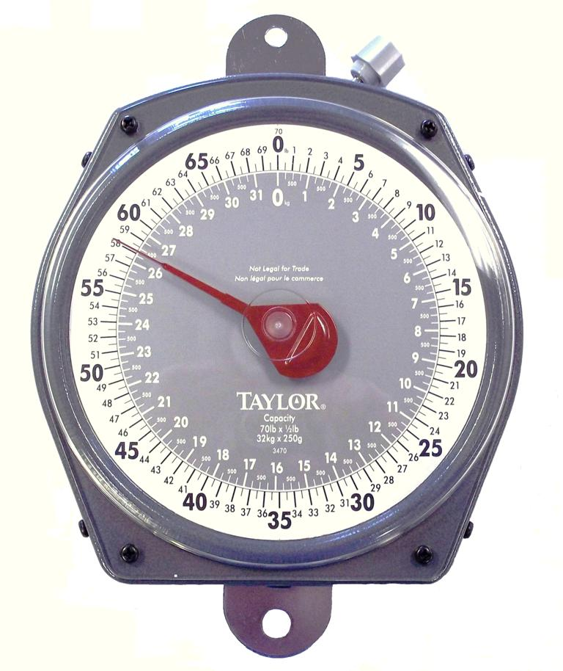
Taylor 3460 and 3470
Low-cost scale
Combination plastic and thin steel
NOT durable and loses calibration easy
Does not like to travel
Treat as disposable scale to send unsupervised/owner-sampler herds

Slide 14
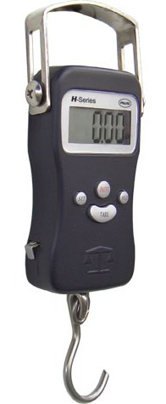
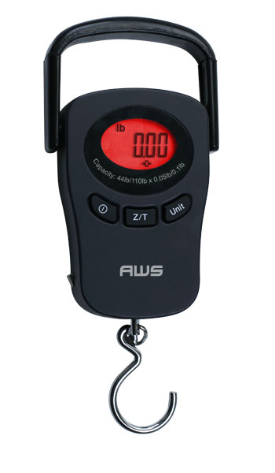
American Weigh Scales – H & PK Series
Digital scale with low purchase price
66 lb. and 110 lb. models available
Easy to carry in computer bag
Accurate but not legal for trade
Can be calibrated
Modern image for DHI providing accurate results

Slide 15
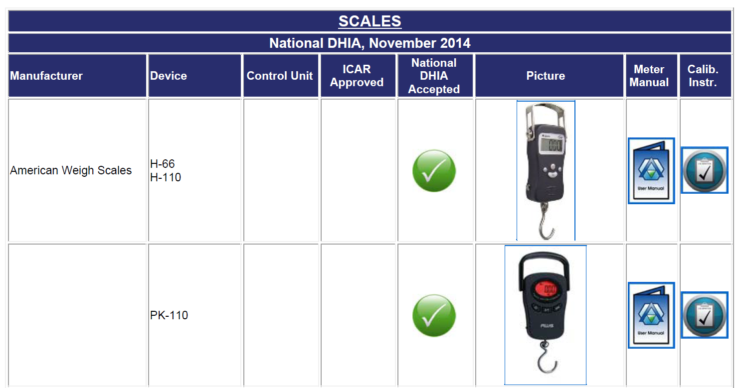
Available Resources on QCS Website
The following resources are a click away
Pictures
Scale Manuals
Calibration Instructions

