Slide 1
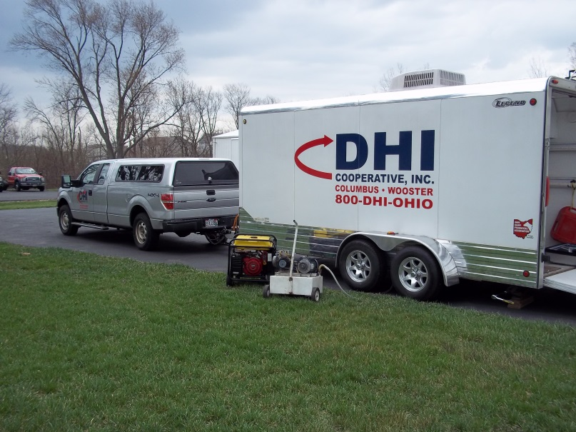
Meter Technician Calibration Procedures
2017 Meter Technician Training School
Steven Sievert
Manager, Quality Certification Services Inc.
Technical Director, National DHIA
Chair, ICAR Subcommittee for Recording and Sampling Devices

Slide 2
Topics to Cover…
Principles of Operation
Calibration Procedures
Troubleshooting
Meter Center Design

Slide 3
Some Terminology for Tru-Test Meters
Sleeve
Nozzle
Cover/Cap
Body & Flask Top
Lower Valve & Housing

Slide 4
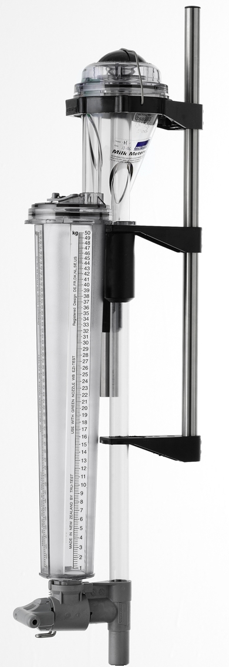
Principle of Meter Operation
Volumetric Meters
Measuring a volume of liquid passing through at a controlled rate and then diverting a precise amount into a calibrated flask to obtain and estimate the total weight of the liquid
Notes:
Cover tip
Radii on sleeve
Inside surface of cover
Inlet tube - join to body
Nozzle
Flask top

Slide 5
Important Facts
The Meter takes a representative proportion of the total milk flow
Measuring pounds of milk
The subsample must represent the entire milking letdown
For accurate components analysis
This can be achieved either
by mixing the collected milk – Pull-Out, Ezi-Test, Farmer, Econo-Valve
by taking a small amount of the milk as it flows by during the emptying process – Auto Sampler

Slide 6
Vacuum Drop
There are five main things which affect vacuum drop:
The type and model of meter
The air admission rate
The flow rate (diameter and length)
The length of extra tubing added to the system to connect the meters
The mounting position of the meter - high or low
Notes:
High line is not so variable as the Meter cannot be mounted in too many different ways I.e. in all cases the milk has to go up.
In low line the mounting can make a difference to the direction that the milk goes I.e. all down or with some up.

Slide 7
Standard Flow Water Test
Requires Air Admission Inlet
Hole from a #60 drill bit
After the in-line water restrictor
24”- 36” from the meter inlet
Water Restrictor has 1/8” Opening
Flow Rate = 8 lbs/minute (4:34)

Slide 8
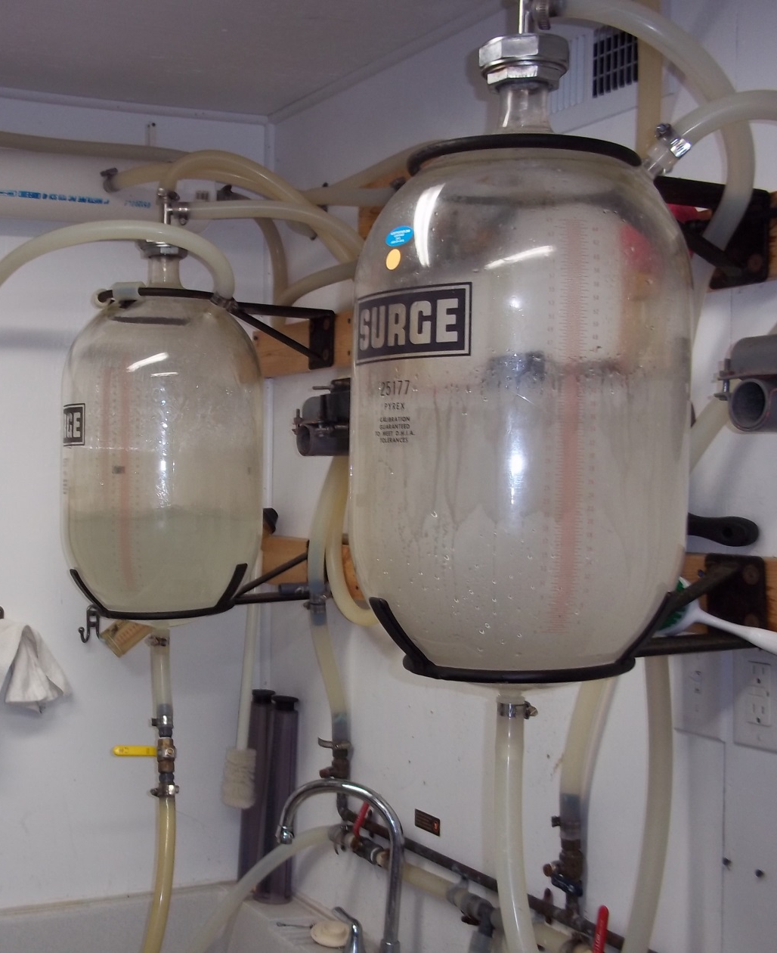
Standard Flow Water Test - Options
Closed Jar-to-Jar System

Slide 9
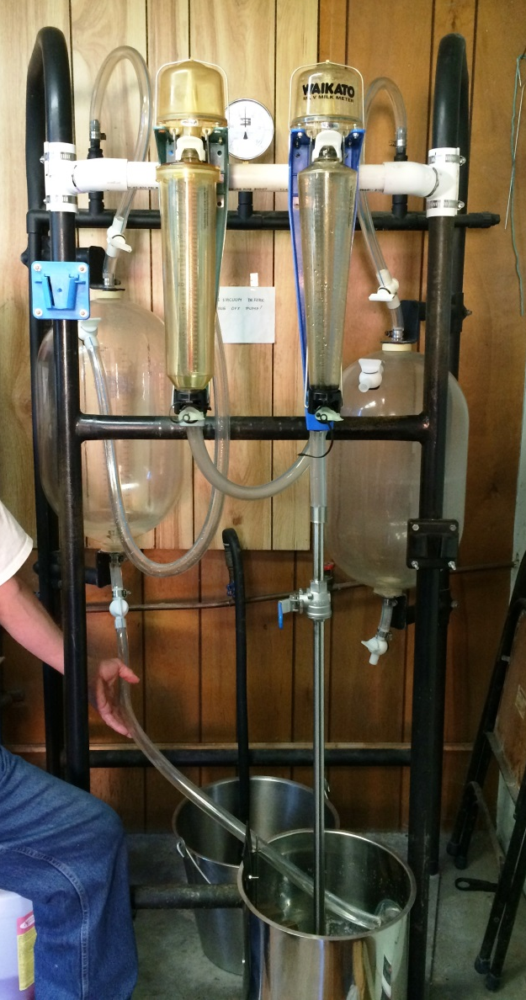
Standard Flow Water Test - Options
Use of Standard Flow Wand from Waikato
& Tru-Test Fast Flow Bucket

Slide 10
Dual Meter Water Test
Same set up at Standard Flow Water Test
Second Meter can be connected in series
24”- 36” hose from outlet of meter 1 to inlet of meter 2
No second air admission inlet is needed
Flow Rate = 8 lbs/minute (4:34)

Slide 11
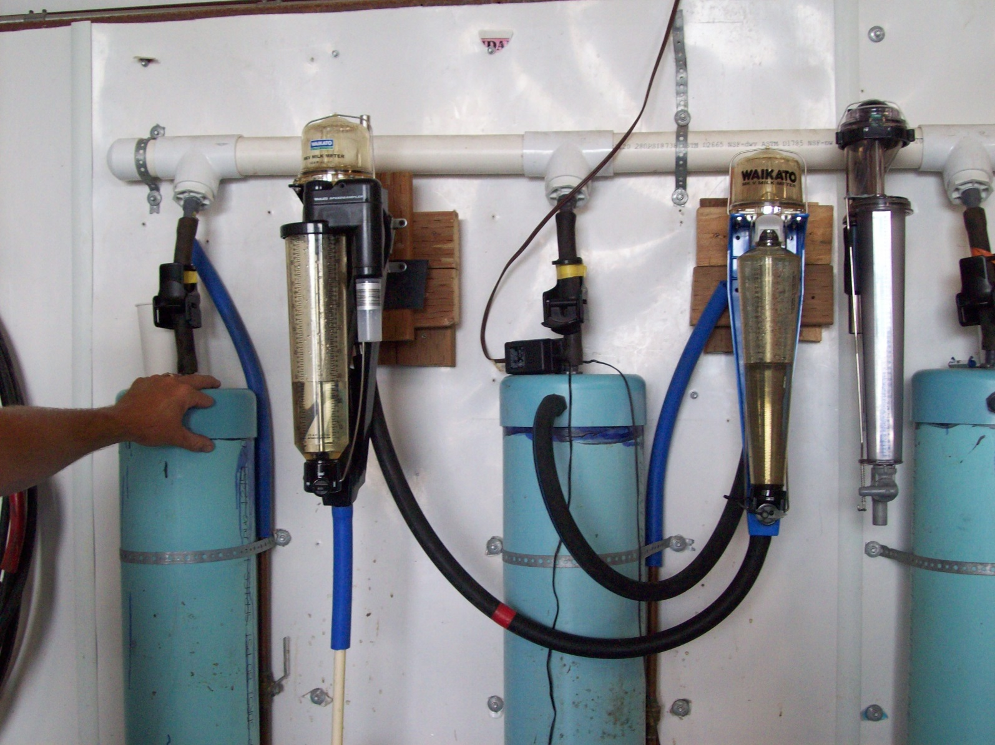
Dual Meter Water Test

Slide 12
Fast Flow Water Test
63” From Bottom of Pail (restrictor) to Top of Meter Flask
Use a Pre-Cut Stick to Quickly Verify
Use a Marker or Tape to Mark Off 63”
Water Needs a Straight Run to the Meter
Wide Bore Meters = 58-65 Seconds
Standard Bore Meters = 65-68 Seconds

Slide 13
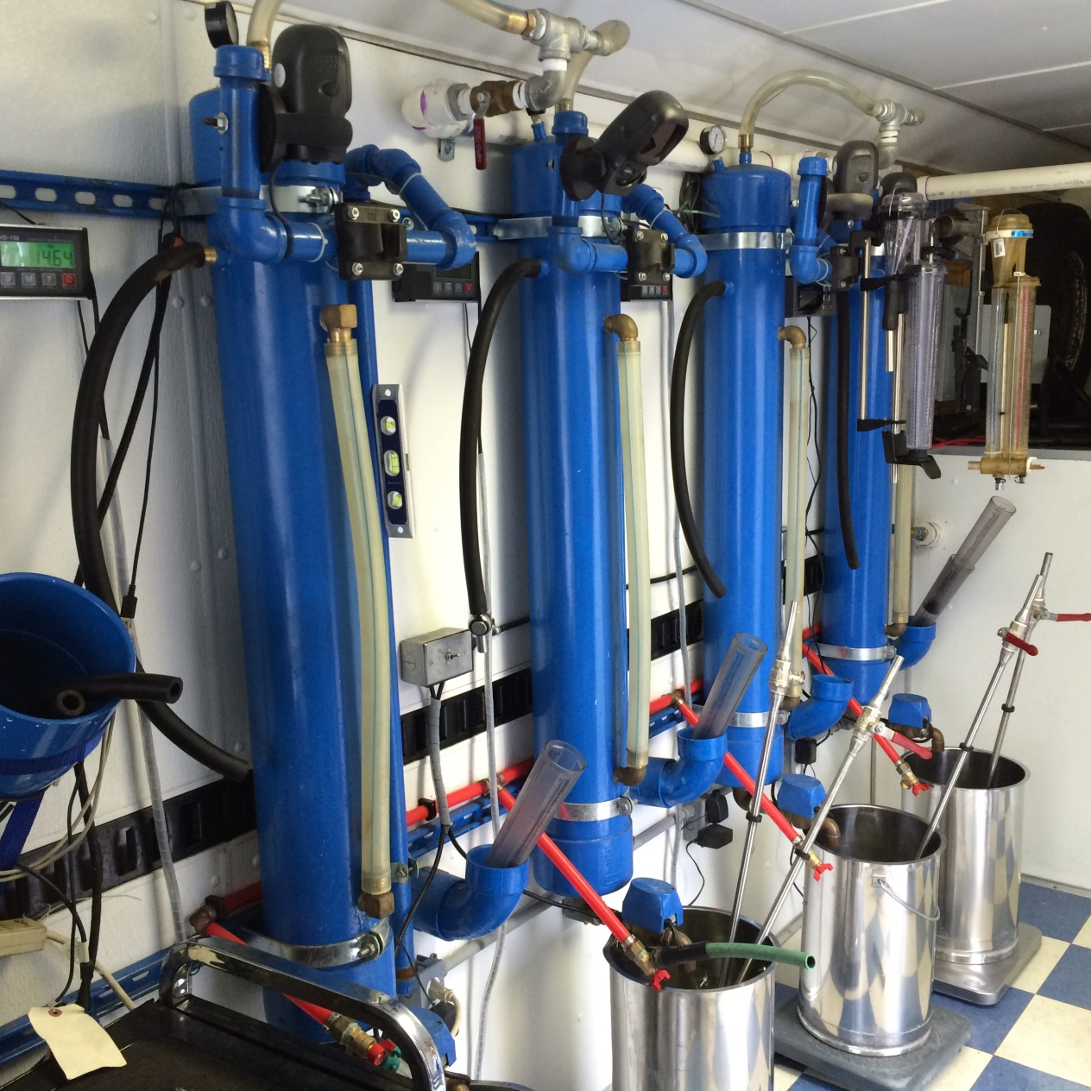
Fast Flow Water Test

Slide 14
Getting Started
Inspect Meter
Mount Meter on Rig
Verify Correct Height
Fast Flow = 63” to Top of Flask
Hose is Straight as Possible
Verify Water Volume
16 Liters / 16 kg / 35.3 lbs
Verify Vacuum Level - 15” hg

Slide 15
Meter Installation
The Meter should be mounted within ±5 degrees of vertical
Take-offs - install Meters between the sensor & milk line to maintain vacuum for agitation and sampling
Air Bleed - must introduce air into the line, usually at the claw

Slide 16
Clean Equipment
Meter Rig
Are Hoses in Good Condition?
Is Water Changed Regularly?
Field Techs Are Supposed to Keep Meters Clean!
Vacuum Pump Maintenance
“If I adjust it, it could break”
“What Oil????”

Slide 17
While You Run
Check for:
Air Leaks
Blockages / Flow Restrictions
Abnormal Performance
Remove Old Calibration Tag

Slide 18
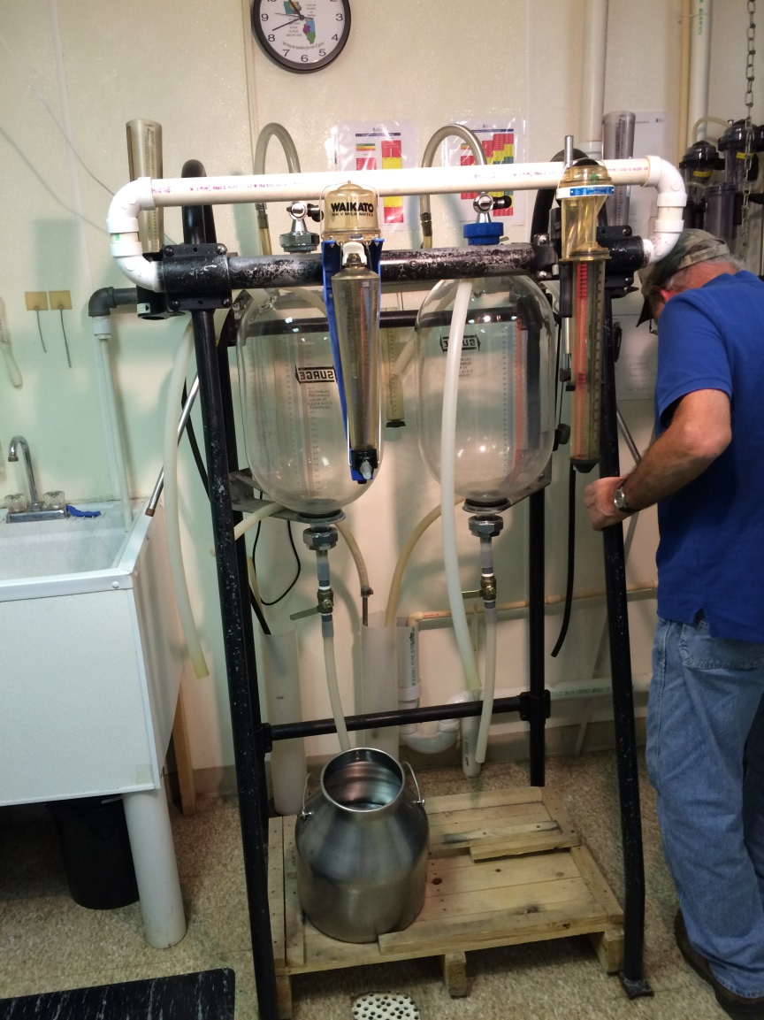
Meter Calibration Requirements
All meters must be calibrated at least once every 12 months
Calibrated to:
2% accuracy on single weight
3% accuracy on two consecutive weights
Data is reported to QCS as part of annual field service audit

Slide 19
Meter Calibration Requirements

Slide 20
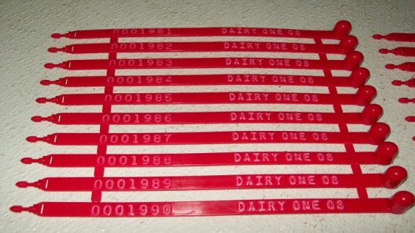
Meter Calibration Tag Options
Guidelines require tag with meter center name along with month and year of calibration

Slide 21
Reporting Meter Calibration Results
Scale no | FT | Make | Model | 2013 Date | 2014 Date | Int | MC | MT | Initial | Second | Final | 2015 Status | 2016 Status
174434 | 999 | Tru-Test | WB AS | 7/7/2016 | 9/12/2016 | 67 | Meter Center Name | Meter Tech Name | 37.5 | 37.5 |  |  | RTS 2016
Proper reporting improves audit efficiency
Unique serial number – avoid alphanumeric values
Make and model of meter
Calibration date(s)
Meter center and technician name
Calibration weights
Status during the audit period

Slide 22
Reporting Meter Calibration Results
Suggested Status Codes for Meter Calibration Worksheets
Active
New (+ year) – meter new from the box
Return (+ year) – repaired meter or returned to active status
Storage – calibrated meter not in active use (backup)
Out (+ year) – meter taken out of service
Perm Out or POS – broken meter (body) that cannot be repaired

Slide 23
Periodic and Annual Maintenance
Milk meters should be periodically checked and maintained
Disassemble and clean the sample valve and meter body. Info Sheets and brushes are available for this procedure.
Wash all parts in very hot water with a proper dairy detergent.
Rinse all parts in clean water after the hot detergent wash.
Notes:
Have valves to disassemble

Slide 24
Periodic and Annual Maintenance
Inspect all rubber parts for cracks and wear in order to minimize build up of bacteria “grunge” and to assure proper sealing of gaskets and O-rings.
Use a safety pin or “pick” to remove the o-rings so that the plastic grooves are not scratched or damaged.
Water test to ensure that the meter is in proper calibration.

Slide 25
Several Runs Later….
If You Can’t Check the Water Before Each Run, Then……
Now is a Good Time to Verify Water Level
How clean is the test water?
You Know What to Do!!!
Is Vacuum Gauge Holding at 15” hg?

Slide 26
Maintaining Water Volume
Electronic scale is best
Etch or tape a mark on the float pail or jar
If it is a float pail - is the float working?
Float Should Move Freely
Most Floats are in Disrepair

Slide 27
Cleaning
Most dairy detergents can be used at the strengths recommended by the manufacturer
Avoid contact with:
Direct Sunlight
Petrochemicals & Hydrocarbons such as fly spray, brake or hydraulic fluid, WD40, lubricants, super glue, alcohols, and fuels
These chemicals attack polysulfone plastics that make up the key meter components
Notes:
Turn valve to sample position while flask is full to empty through valve and wash it out.

Slide 28
Trouble Shooting
Milk Meter Cover
Symptoms = abnormal readings
Cap Point Sharp & Smooth
Seated properly on Body
Look for Internal Scratches or Damage
Notes:
Point - abrasions and dents
Scratches - especially Metering quadrant

Slide 29
Trouble Shooting
Nozzles
Gap across the nozzle is very controlled to ±0.01mm (0.0003”)
Check for scratches or ridges on top
Seated properly in holder
Abrasion or signs of wear on sides
Debris (cottonseed, corn, etc.)

Slide 30
Trouble Shooting
Sleeve & Funnel
Should be concentric - 3 legs seated properly - Not Loose
No nicks or scratches since they will affect how the milk is spread out onto the inside of the cover
Objects lodged inside or lower in the meter base – watch for broken baffle pieces lodged inside the rubber sleeve

Slide 31
Trouble Shooting
Meter Body
Look for possible leaks
Symptoms = Low Reading or Hissing
Check rubber flask seal – not rolled
Look for hairline cracks
Is the rocker free to pivot and seal?
Look for possible blockages
Symptoms = slow draining, no stirring

Slide 32
Trouble Shooting
Cracks in Body or T-piece
Generally caused by one of four factors
Being dropped during loading/unloading
Chemical or alcohol attack
Improper disassembly or handling
Hoses put on too far (3/4” is plenty)
Parts that have been molded in or glued in during the assembly process are annealed to reduce the stresses

Slide 33
Trouble Shooting
Milking Equipment Problems
Areas to check:
Air admission hole in claw must be open
Adequate vacuum pump capacity/setting
Condition of gaskets & O-rings - air leaks?
Proper installation height of meters
Length of hoses used to connect meters

Slide 34
Worker Friendly Meter Center
Is Your workspace really a workspace?
Dedicated work area for meter repairs
Adequate lighting and ventilation
Arrange your area for efficiency
Parts within reach
Tools nearby and tools you need
Workbench close to calibration rig and parts

Slide 35
Clean Work Area Makes a Difference
Are you stepping over things?
Floors clutter free?
Meters stored to prevent damage?
Are things put away when you’re done?
Are you moving yesterday’s work out of the way so you can work today?
Are floors clean dry / non-slip?

Slide 36
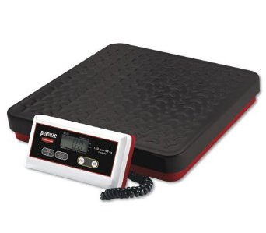
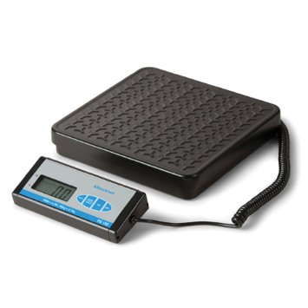
General Observations from Meter Centers
Platform scales for initial water verification are failing
Limited lifetime
Usually one of four load cells fails leading to scale being off by a percentage
Limited options under $200

Slide 37
General Observations from Meter Centers
Still observing unapproved meter modification in some affiliates
Modification of parts so the meter samples faster resulting in inaccurate samples
Removal of ball in valve of the Tru-Test Ezi-Test meter
Cutting the tap of the Waikato MK V meter
Modification of the sampler in the Tru-Test Auto Sampler meter

Slide 38
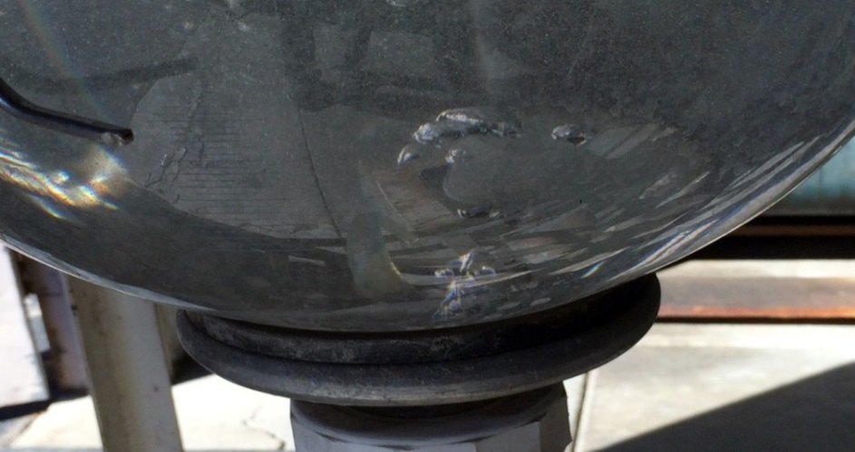
General Observations from Meter Centers
Equipment is aged beyond useful life in many meter centers
Vacuum pumps/gauges are failing
8 in 2014, 2 in 2015, 6 in 2016
Receiver jars with air leaks, buildup
5 in 2014, 5 in 2015, 7 in 2016

Slide 39
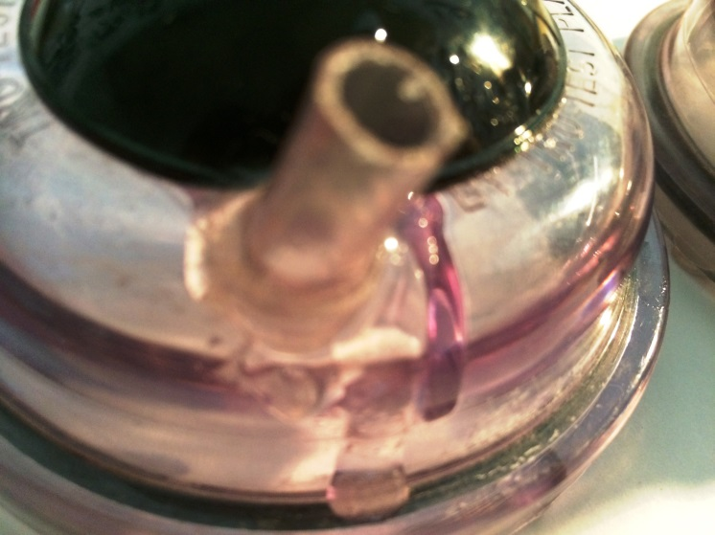
General Observations from Meter Centers
Trying to repair cracked bodies or caps with glues/cement
Weakens the whole meter
Introduces air leaks
Not approved for Grade A dairies (PMO/FDA)

Slide 40
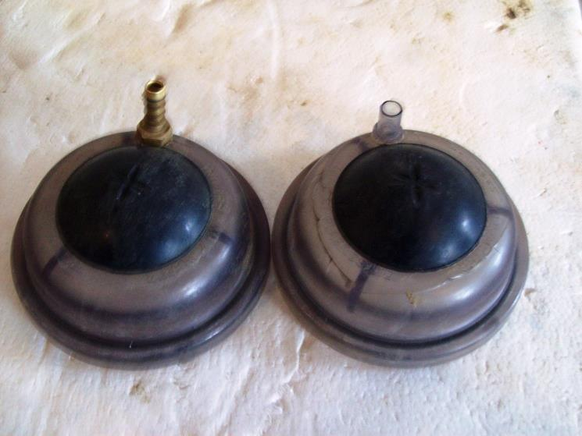
General Observations from Meter Centers
Unapproved meter modification
Trying to repair broken hose nipples on bodies or caps
Brass hose connectors
Ballpoint pens
Not approved for Grade A dairies (PMO/FDA)

Slide 41
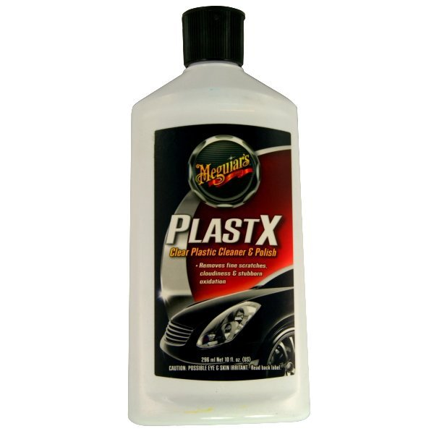
Keeping Flasks Looking Great
Remove cloudiness from aged flasks
Makes washing/cleanup easier
Notes:
Turn valve to sample position while flask is full to empty through valve and wash it out.

Slide 42
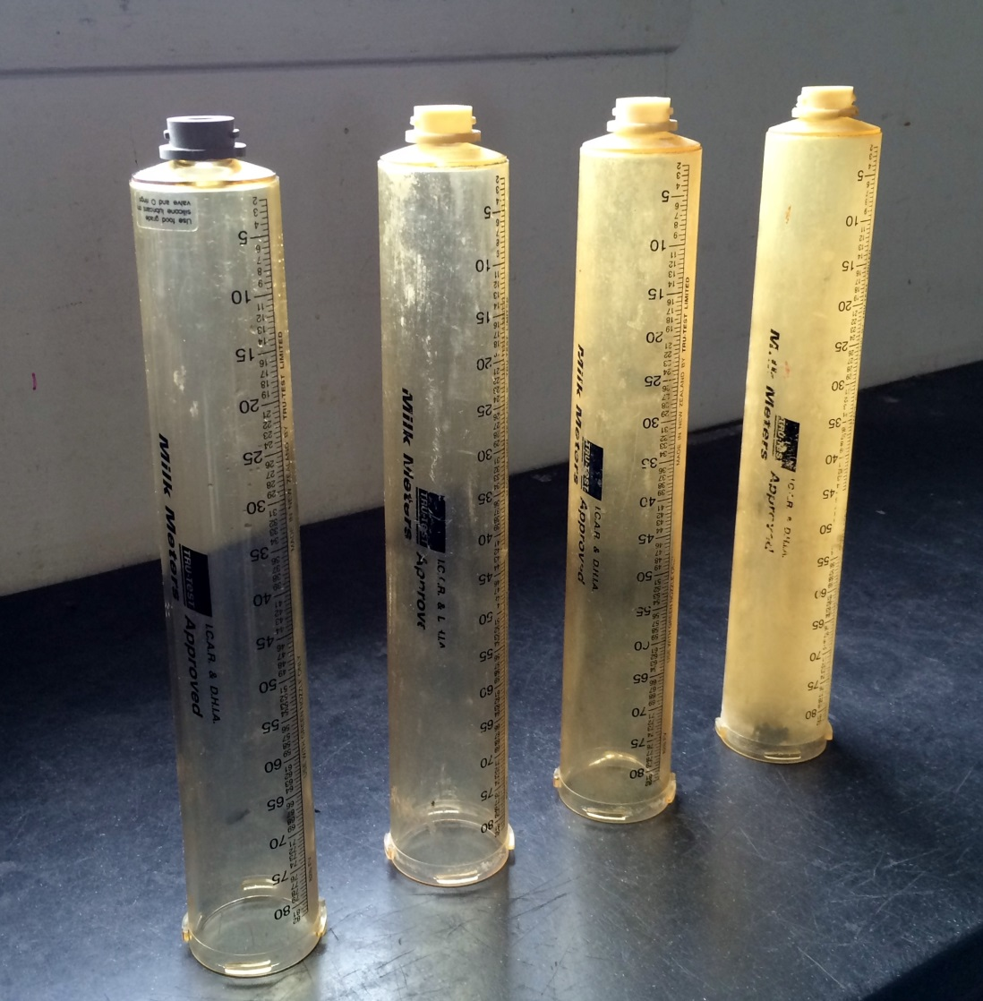
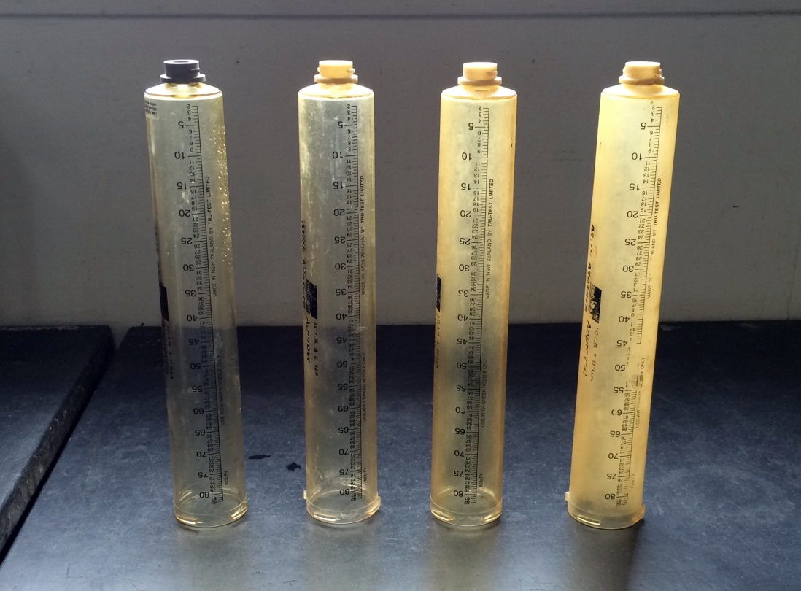
Keeping Flasks Looking Great
Notes:
Turn valve to sample position while flask is full to empty through valve and wash it out.

Slide 43
Keeping Flasks Looking Great
Notes:
Turn valve to sample position while flask is full to empty through valve and wash it out.

Slide 44
Organized Inventory
Labeled Parts
Do You Really Know What’s What?
How Many “Mystery” Parts Do You Have?
Parts in Compartments/Bins
Organization = Efficiency
Efficiency = Speed

Slide 45
Meter Technician’s Job Responsibilities
Verification
Repair and Calibration
Responsible
For the Very Foundation of the DHI Industry
Be Proud of Your Job and Take Your Responsibilities Seriously

Slide 46
Resources Available On-Line
QCS website is your source…
Current auditing guidelines
List of certified meter centers
List of certified meter technicians
List of approved meters and scales
Links to manufacturers
www.quality-certification.com

Slide 47
Quality Certification Services Inc.
Performance & Quality Standards
Compliance Auditing of Providers
Education, Training, & Development
A simple, yet vital mission….
Providing a reliable source of information to people interested in the U.S. dairy records industry.

