Slide 1
Understanding the
National Dairy Herd Improvement Program
Uniform Operating Procedures
(Code of Ethics & Uniform Data Collection Procedures)
April 2014

Slide 2
Revisions to the UOP
Uniform Operating Procedures was last reviewed in 2002 and is currently made up of:
Code of Ethics
Uniform Data Collection Procedures
Records Disclosure Policy
The Records Disclosure Policy will be moved into a separate document and reviewed by the Release & Use of Records Task Force in 2014
Revisions were made to Code of Ethics & Uniform Data Collection Procedures by the UOP Task Force

Slide 3
Uniform Operating Procedures
Code of Ethics
Uniform Data Collection Procedures
Revised and Adopted by National DHIA Board of Directors on March 9, 2014
Effective June 1, 2014

Slide 4
Scope of 2014 Revisions
The Task Force focused on:
Uniformity in DHI data and programs
Relevance to today’s DHI program
Inclusion of new technology and data
Organization and program needs
Electronic identification
Automatic milking systems and newer recording devices
Health and diagnostic screening data

Slide 5
Code of Ethics
The Code of Ethics provides guidelines for appropriate conduct in the production, collection, and distribution of DHI information for all individuals and organizations involved with these data.

Slide 6
Unethical Procedures
Impairing the reliability of DHI data.
Not cooperating or interfering in the use of the Uniform Data Collection Procedures to record DHI data.
Intentionally providing inaccurate data or withholding necessary data resulting in misrepresentation of DHI information.

Slide 7
Unethical Procedures
Engaging in management practices with the intent of misrepresenting the performance of individual animals and/or the herd.
Are the movement of animals between herds,
Influencing the relative performance of herd mates, and/or
Selective use of management techniques in an effort to bias DHI data.
Permitting the collection of supervised data by a technician with a direct financial or family interest in the herd being tested without notification to and consultation with the field service auditor.

Slide 8
Uniform Data Collection Procedures
The purpose of these procedures is to provide the framework for a uniform, accurate system that will enhance data reliability.
The data are used for
Dairy Management Decisions
Genetic Evaluations
Education & Research
Promotion &
Sales

Slide 9
DHI Service Providers
DHI Service Providers, DHI personnel, and dairy herd owners and their employees are responsible for adherence to the UOP.
Field Service Providers
Laboratories
Meter Centers
Meter Technicians
Dairy Records Processing Centers

Slide 10
DHI Technicians & Sample Takers
Field Service Provider
Employee Field Techs
Sample Takers
Independent Service Providers
Sample Takers
Required Annual Training
Training by Field Employer
County Association Field Techs
Sample Takers
Required Annual Auditing of Field Service Activities

Slide 11
Data Collection Procedures
Proper Collection of Milk Weights & Samples
Supervised Test
Unsupervised Test
Partially Supervised Test
Automatic Milking – Robotic Test
Supervised Test with Electronic Meters
Unsupervised Test with Electronic Meters
Partially Supervised Test with Electronic Meters

Slide 12
Standard Equipment
Portable Meters
Scales
Weigh Jars
Electronic Meters
DHI Field Service Equipment
Dairy Producer Equipment
Must be:
Approved Model
Includes Meter, Sampler, and Software
Calibrated Annually
Marked with Calibration Tag

Slide 13
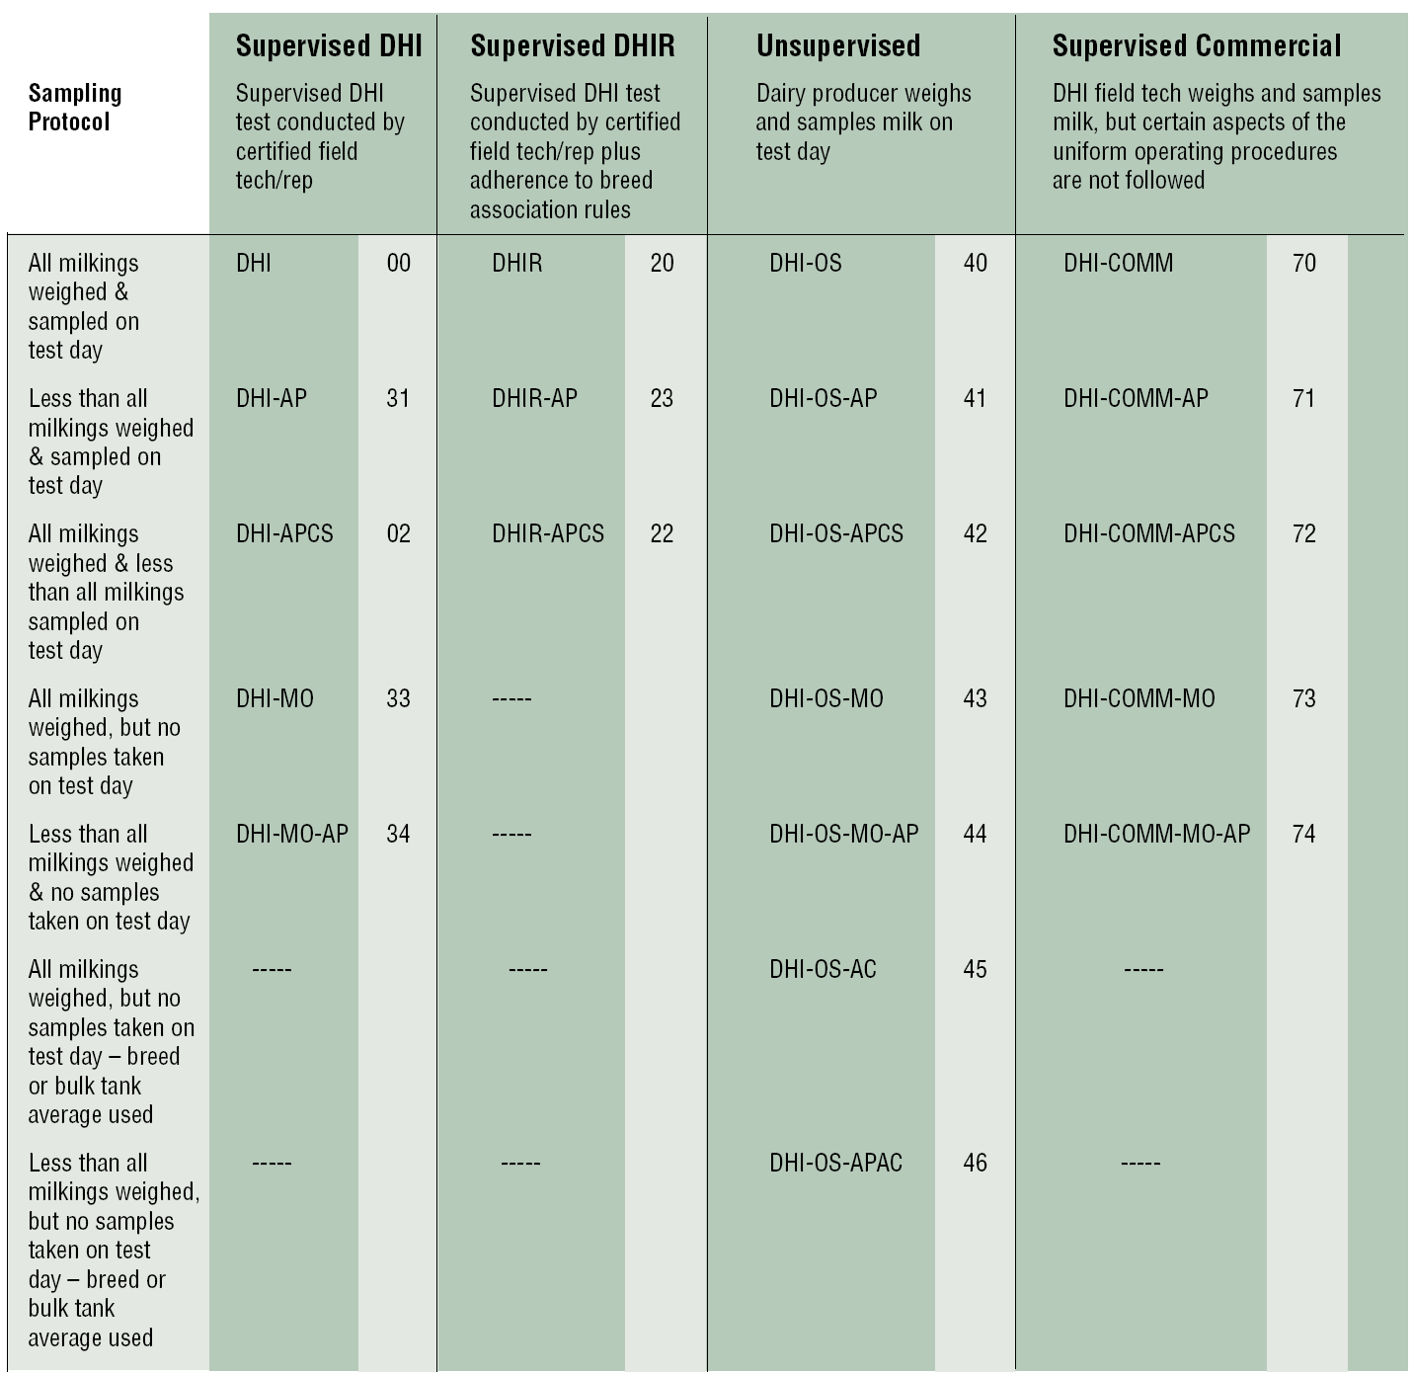
ApprovedTest Plans

Slide 14
Data Collection Standards
Must test all cows in the herd.
Cows must be visually identified with permanent identification number or registration number.
Milk shipped (also known as bulk tank measurements) totals must be reported.

Slide 15
Data Collection Standards
Fresh Cows
Cows fresh four or more days beginning the evening milking of the fourth day after calving or the morning of the fifth day for AM- PM herds
Dry Cows
The dry date is the 1st calendar day the cow is not milked.
Cows Leaving the Herd
Last calendar day cow was in the herd.
Cows entering herd
Calendar day following the last day of credits in former herd.

Slide 16
Data Collection Standards
Sick Cows
Actual production recorded and coded as abnormal (CAR Code)
Cow’s record will be adjusted accordingly.

Slide 17
Data Collection Standards
Code aborted cows
If carried calf less than 152 days record will continue.
New lactation if calf was carried 152 days or longer.
Cows calving without going dry
Record ends on day prior to calving.
New lactation begins on calving date.
Prepartum milk is not counted.

Slide 18
Data Collection Standards
All estimates for missing milk weights and sample component results are done by the DRPC.
Transfers between field service providers must be completed within 15 days
Transfers between DRPC must be completed within 48 hours

Slide 19
Adjustment of Milk Weights
to a Verifiable Source
Milk Shipped and Not Shipped Known
If the DHI Field Service Provider has verifiable source for both milk shipped and milk not shipped, the test day milk weights are adjusted at the herd level to sum of both milk shipped and milk not shipped.
Only Know Milk Shipped
If the DHI Field Service Provider has verifiable source for milk shipped but cannot account for milk not shipped, the test day milk weights are adjusted at the herd level to 102.8% of the milk shipped weights.
No Information
In the absence of both milk shipped and milk not shipped, the DHI Field Service Provider shall not adjust the test day milk weights. The normal application of both the 24-hour adjustment and AM/PM adjustment factors by the DRPC shall apply.

Slide 20
Automatic Milking Systems
Data obtained from automatic milking system software may not be used in genetic evaluations unless the system meets National DHIA/Quality Certification Services standards
Test day milk weights will be obtained as 24-hour yield obtained from the automatic (robotic) milking system software. The average 24-hour milk yield reported should represent a minimum of three consecutive days and not to exceed ten consecutive days.
Milk samples shall be obtained using National DHIA accepted sampling devices for one of the milkings during the test day. There will be no application of AM/PM factors on milk samples.

Slide 21
Data Collection Rating
Test Plan | Daily | 10 day LER | 5 day LER | Supervised All | Supervised 2 of 3 | Supervised 1 of 2 | Supervised 1 of 3 | Unsupervised All | Unsupervised 2 of 3 | Unsupervised 1 of 2 | Unsupervised 1 of 3
Test Days per Year | 305 | 100 | 50 | 10 | 10 | 10 | 10 | 10 | 10 | 10 | 10
Weight (%) | 100 | 99 | 98 | 95 | 92 | 89 | 83 | 66 | 64 | 63 | 60
DCR | 104 | 104 | 103 | 100 | 97 | 95 | 90 | 75 | 73 | 72 | 69

