Slide 1

Care and Maintenance of Super Clamps
2017 Meter Technician Training School
Terry Hopper and Gary Thoma
Meter Technicians
Dairy Lab Services
Dubuque, IA

Slide 2
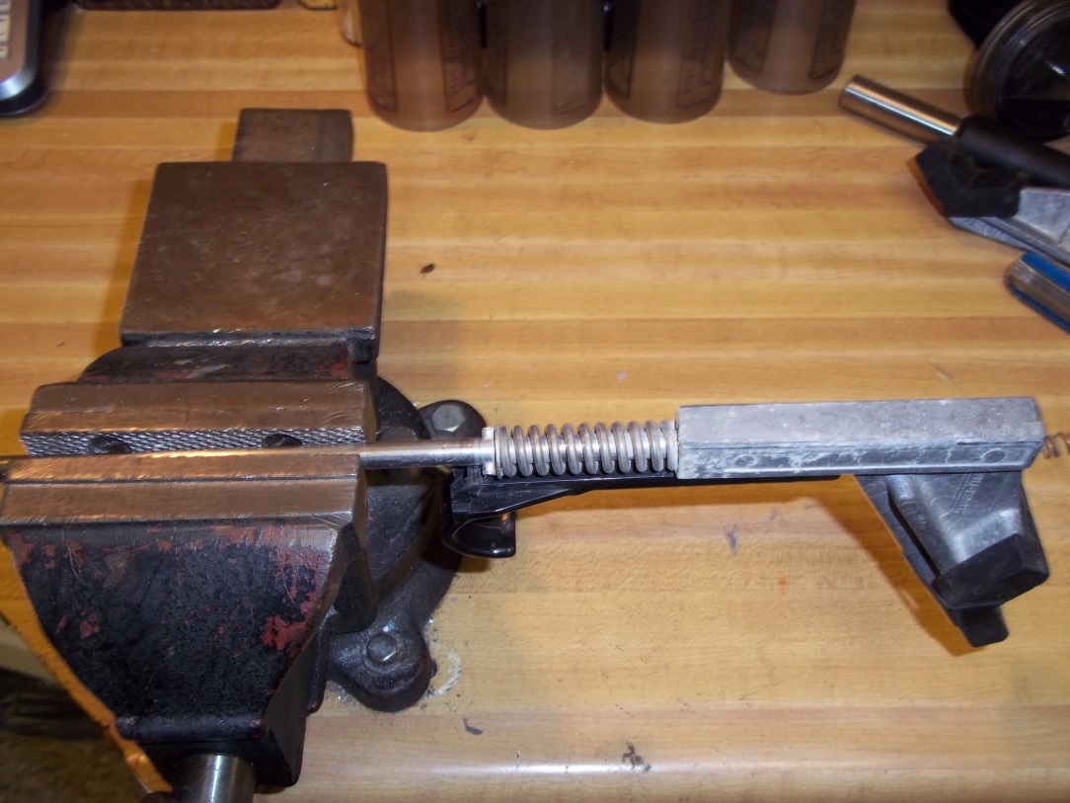
The Most Important Tool in the Meter Shop
Working with a vise adds stability to the meter
Free hands
Improves technician safety

Slide 3
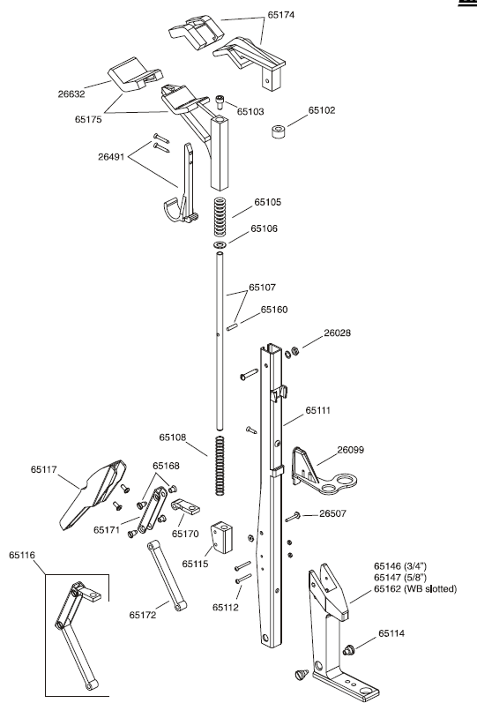
Super Clamp Parts
Exploded view in your manual

Slide 4
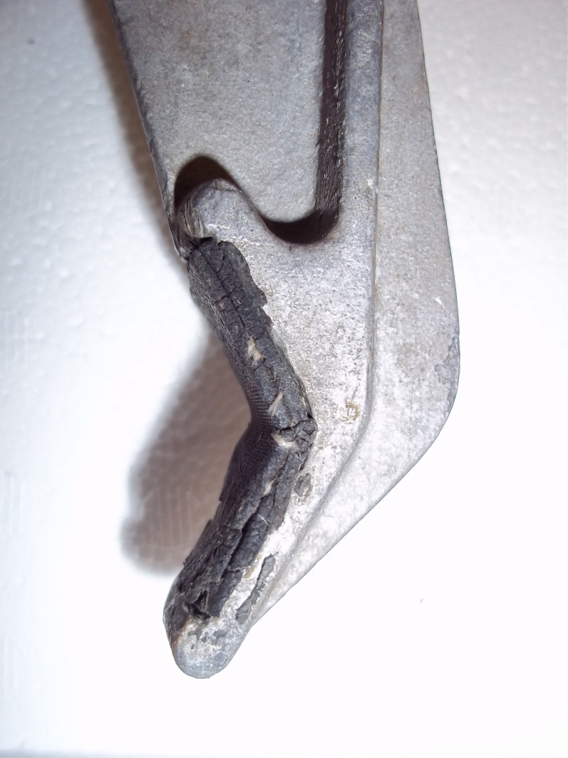
Older Style Jaws
Glue the rubber pads in place
Replacement is time consuming and messy
Wear out quickly

Slide 5
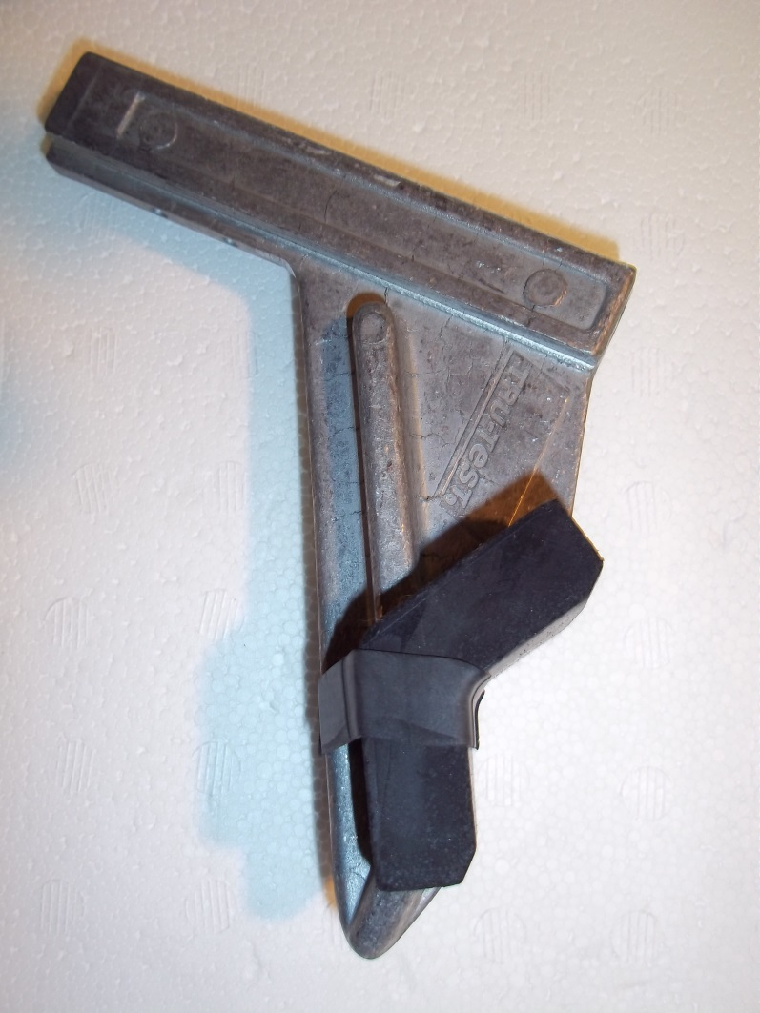
Keeping Jaw Pads in Place

Slide 6
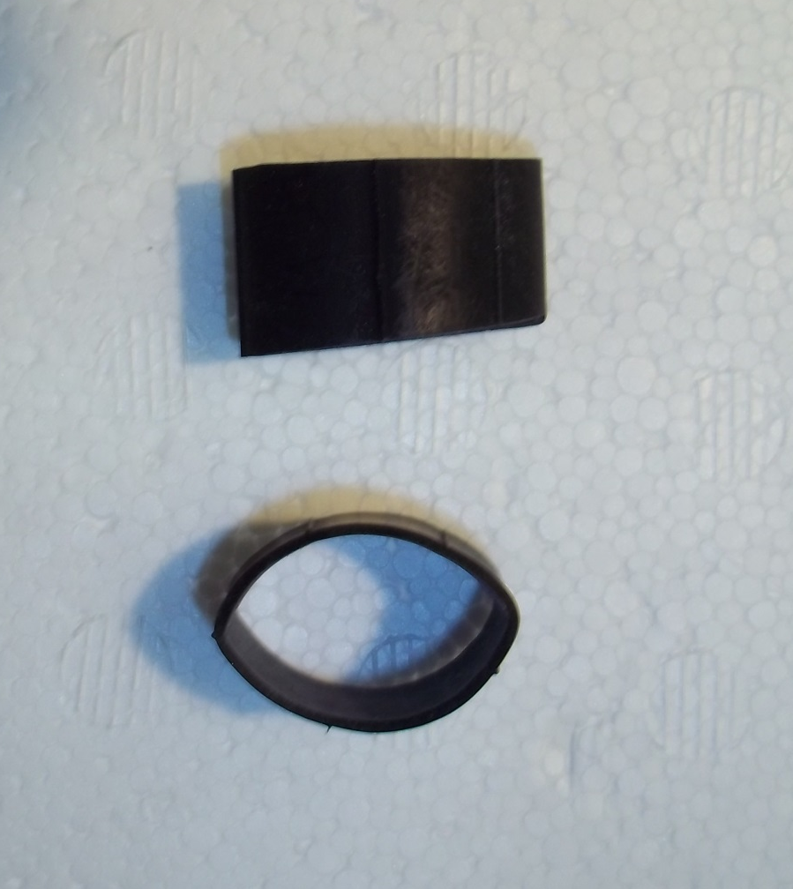
Keeping Jaw Pads in Place
Borntrager’s
Bicycle tube cut into sections
Low cost

Slide 7
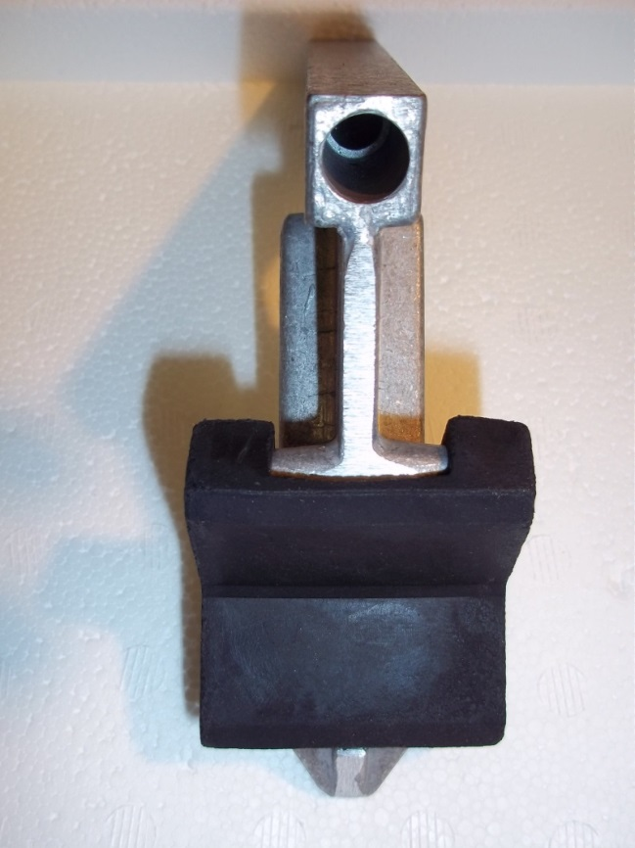
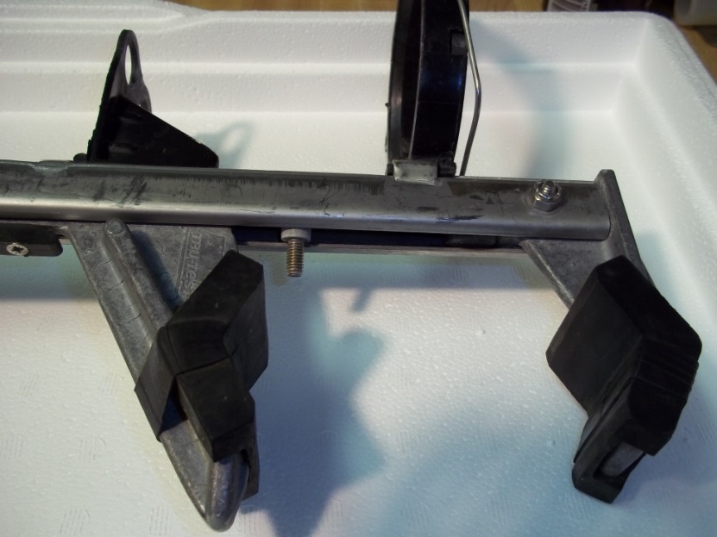
Working on the Jaws
Proper jaw function requires the rod and nut in the lower jaw to be tight
If loose, jaws will not function properly
When top is removed, check the nut on rod for tightness

Slide 8
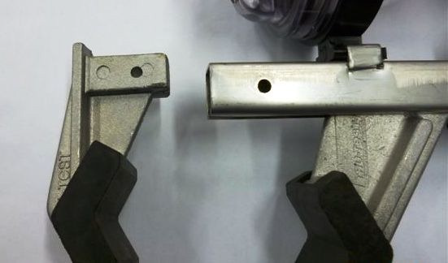
Working on Jaws
Must disassemble the top and bottom jaws for service
Prefer stainless steel nut and bolt – having a magnet helps identify
Easy to clean with water when taken apart
Use wire brush on lower jaw shaft

Slide 9
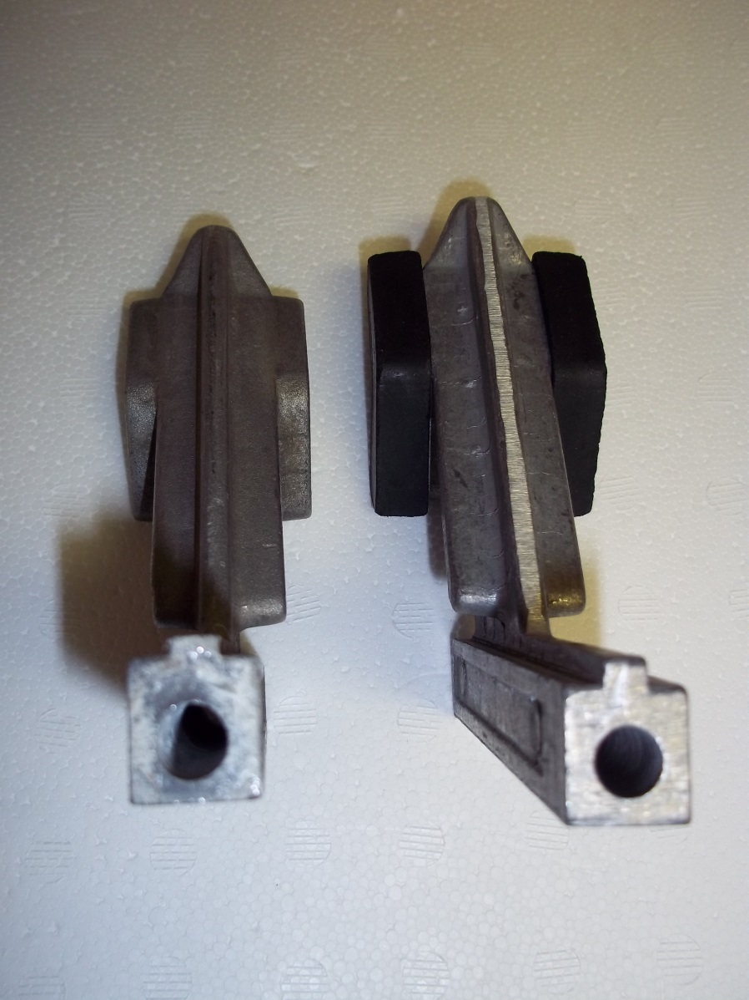
Checking for Wear from the Rod
Inspect lower jaw for wear from the rod
Excessive wear affects clamping mechanism

Slide 10
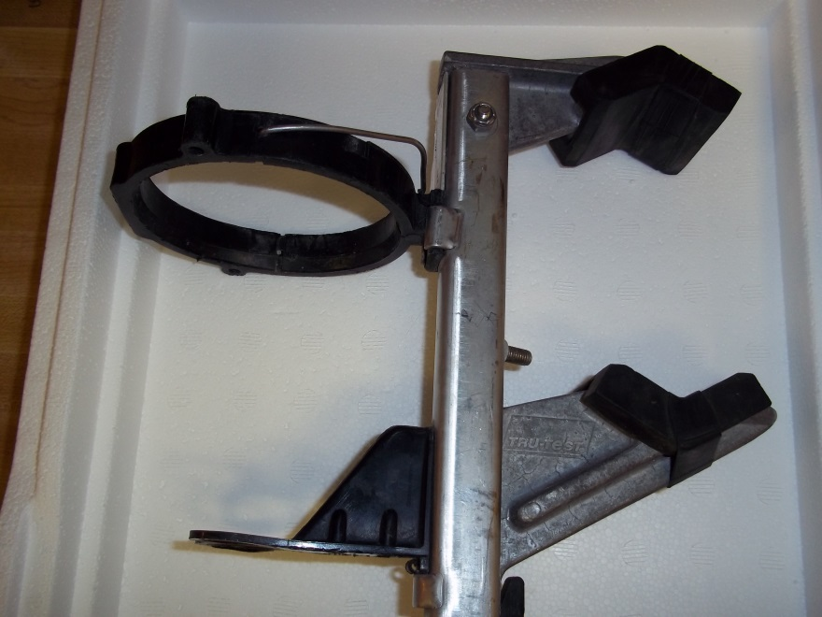
Mounting Ring
Checks for broken or cracked rings
Integral for mounting the meter body
Mounting stay screw is critical
Plate keeps the mounting ring in place

Slide 11
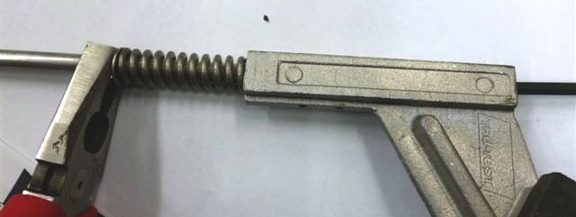
Checking the Roll Pin in the Rod
Check annually
Vise is preferred holding mechanism

Slide 12
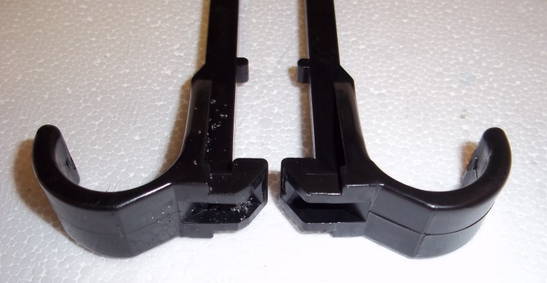
J-Hooks
File New J-Hooks to round the area where the hook hits the catch bolt.

Slide 13
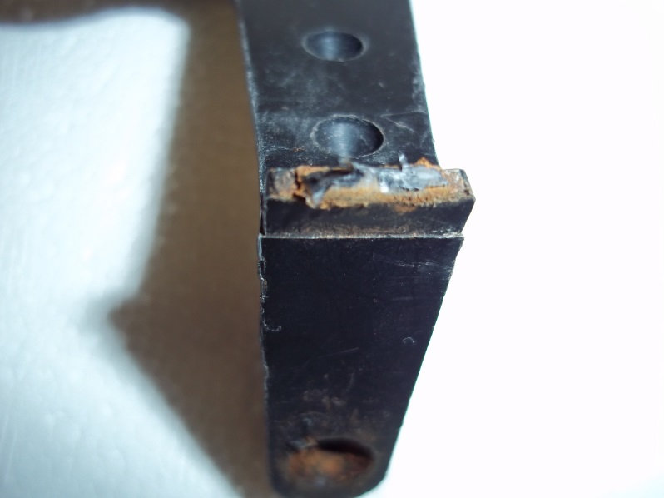
Mounting Stay
Check for breakage on bottom of mounting stay
If broken, flask is not secure
Opportunity for air leaks and missed milk weights

Slide 14
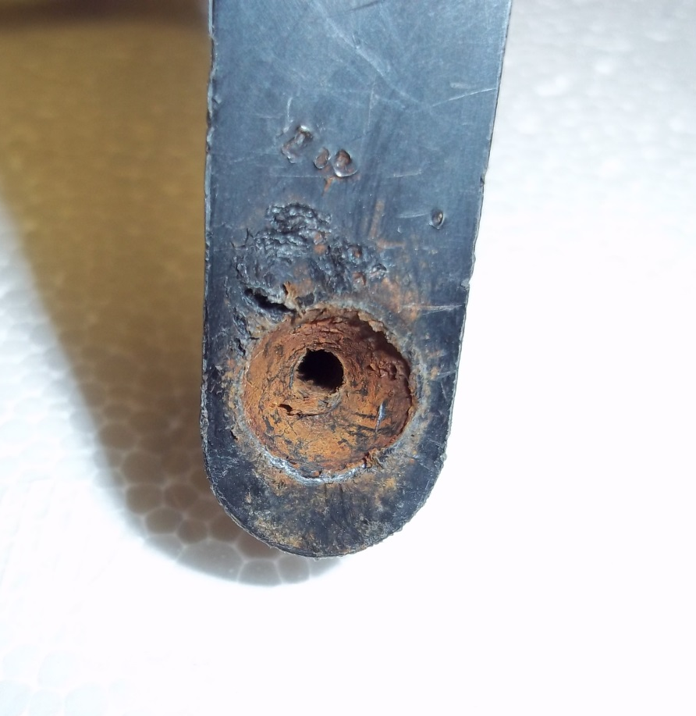
Mounting Stay
Useless stainless steel screws to prevent rusting and screw breakage
Check when jaws are taken apart

Slide 15
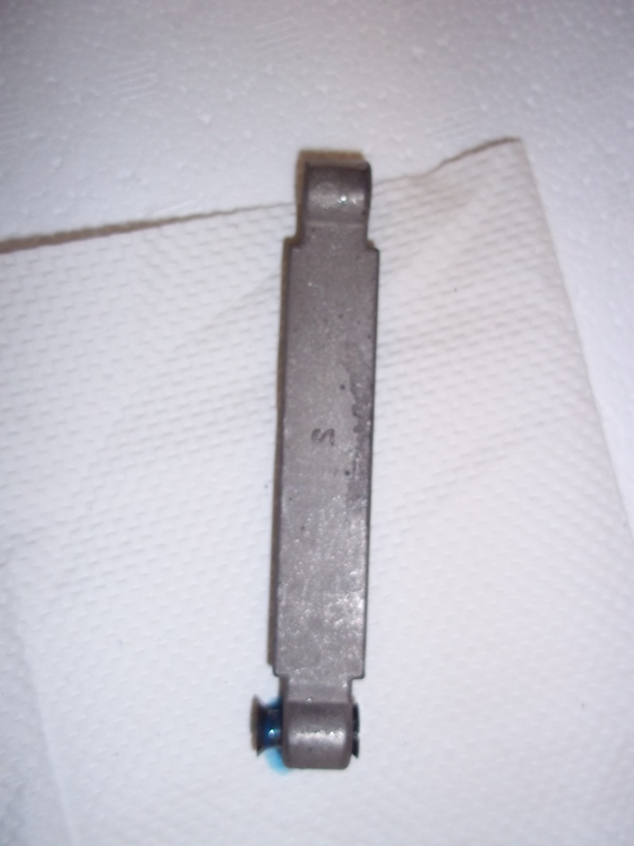
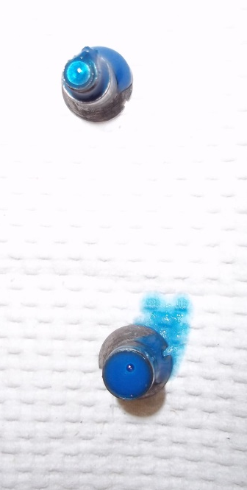
Trigger Lever and Pivot Screws
Upper pivot screw – expensive and fall out easily
Use ONE drop of Loctite to secure
Too much Loctite and trigger will not pivot

Slide 16
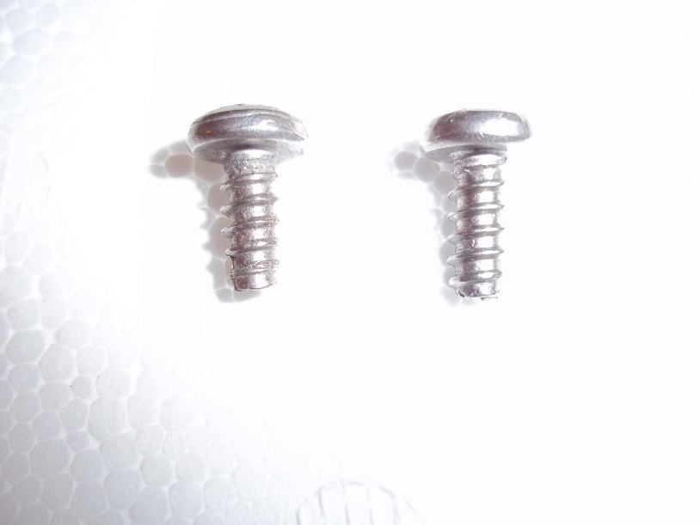
Trigger Screws
Packaged with triggers from Tru-Test
Not the same type of screw though the same part number
Wrong screw would lead to trigger failure

Slide 17
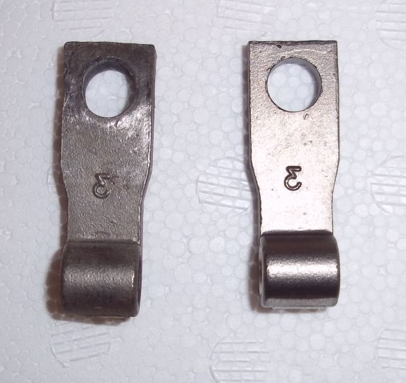
Check Locking Plates
Check for wear in the plate holes
Replace as necessary

Slide 18
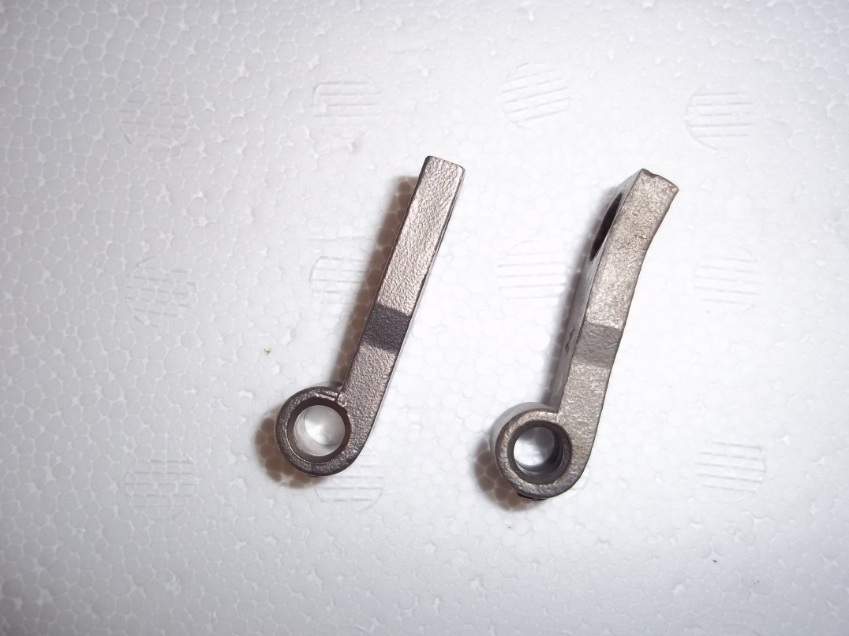
Checking Locking Plates
Check for bent locking plates
Won’t secure the meter to the pipe - movement
Cause??

Slide 19
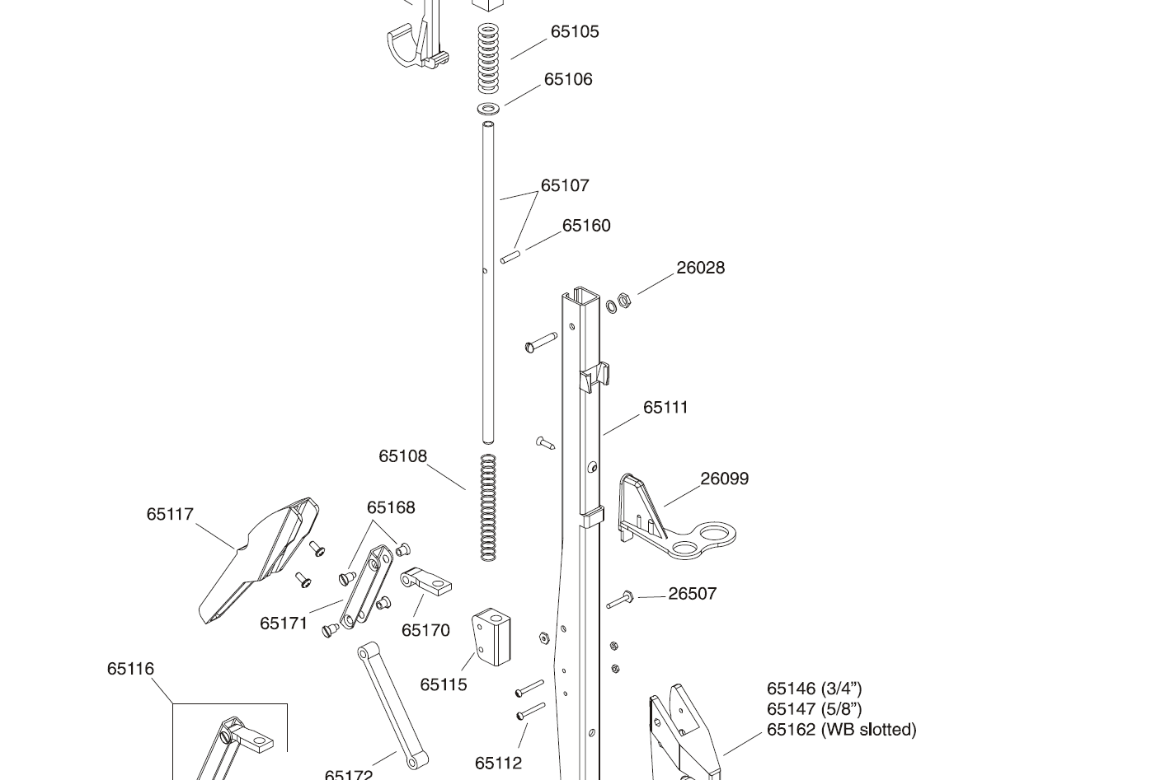
Lower Spring Maintenance
Stretch from roll pin to end of the rod

Slide 20
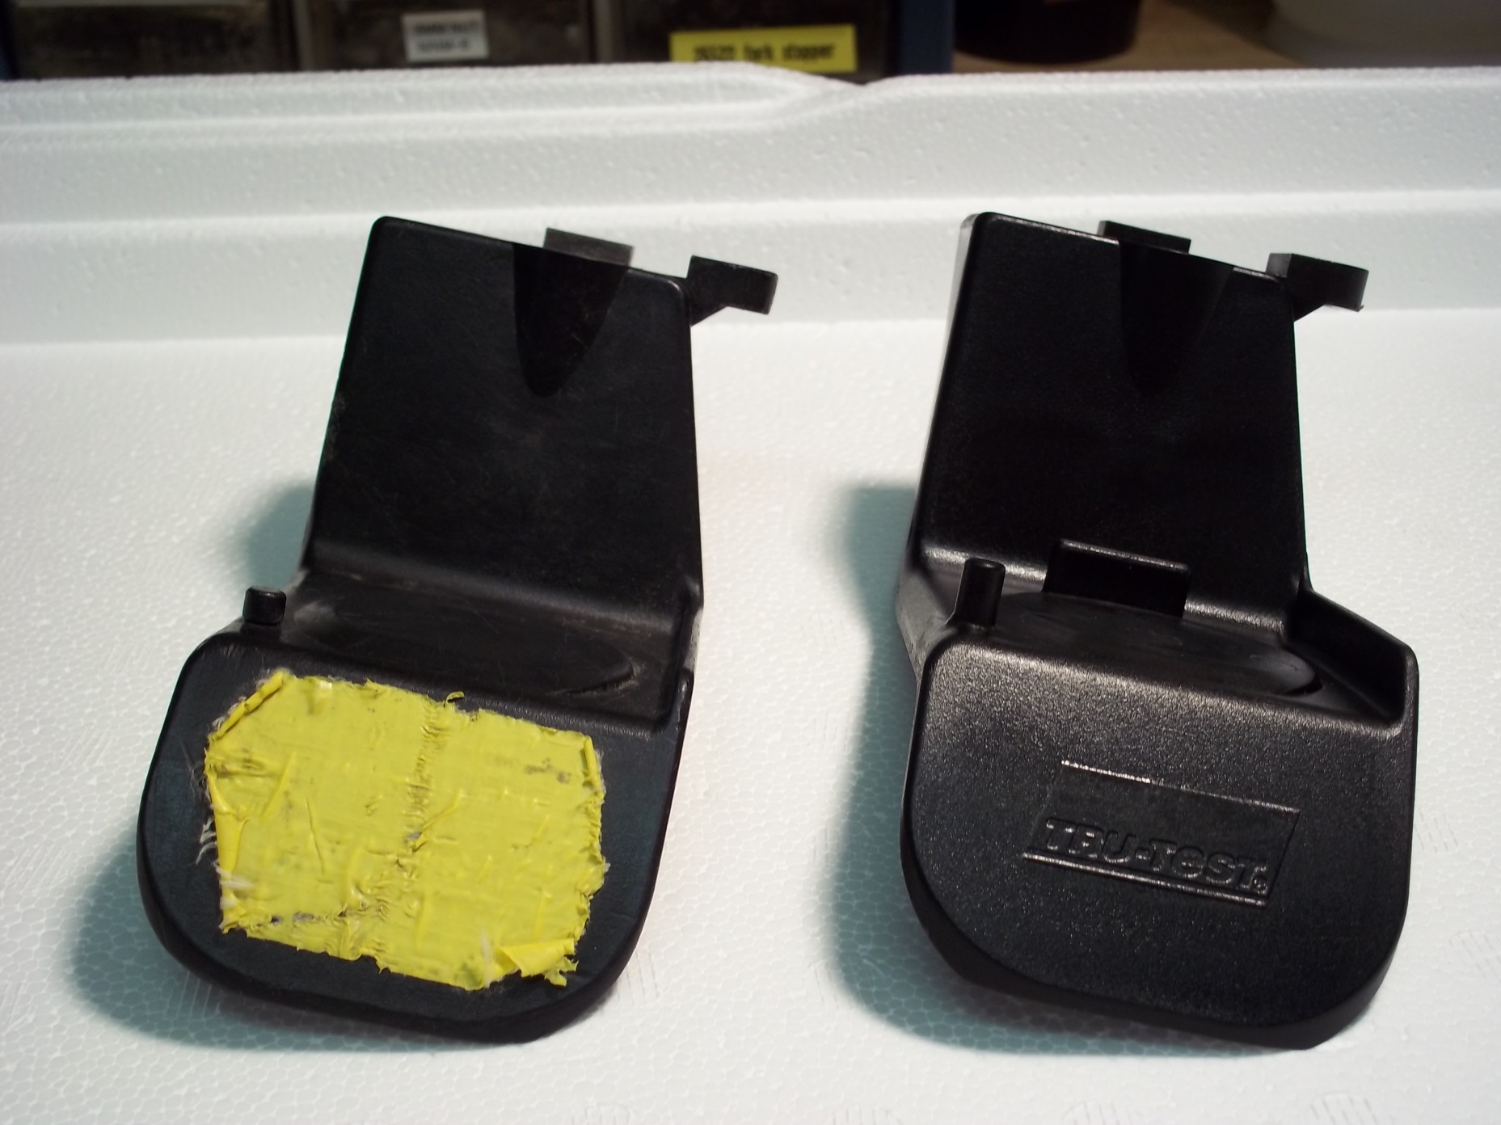
Flask Foot

Slide 21
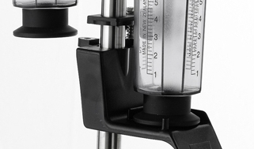
Flask Foot

Slide 22
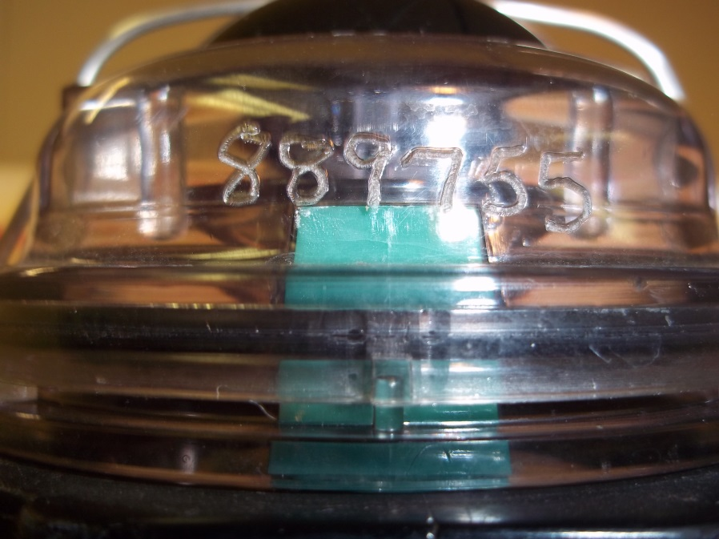
Etch Your Covers
Calibrated meter include body and cover so the field technician reassembles meters correctly

Slide 23
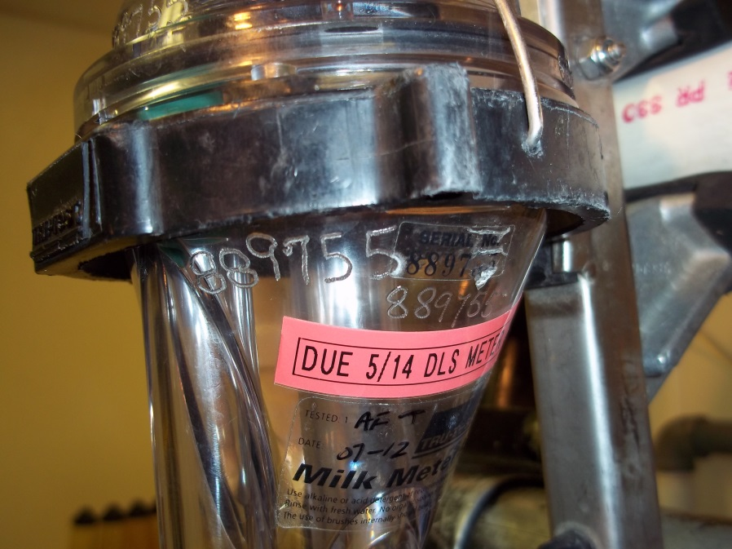
Etch Your Meter Bodies
Factory etching is poorly placed and hard to read
Faster and more accurate meter inventory
Makes the auditor happy!

